Slide 1
Optimization-Based Reduction and Padé Approximants for Lithium-ion Battery Cell Models with Degradation
MS Defense
Jihoon Moon
Texas Tech University
Mar 31, 2022

Slide 2
Outline
Introduction
Lithium-Ion Battery Cell Model
Basics of Lithium-Ion Battery
The Single Particle Model
Model Reduction
Baseline Model Reduction Method
Optimization-based Model Reduction Method
Padé Approximation
Simulation and Optimization Setup
Results and Discussion
Conclusion
1
Notes:
This presentation is divided into 6 parts. Introduction, Basics of the Lithium-ion battery, Model reduction, Simulation and optimization setup results and discussion conclusion

Slide 3
1. Introduction
This presentation studies model reduction for a physics-based, electrochemical lithium-ion battery model by the Padé approximation, finite difference method, and optimization-based techniques
Modeling
Battery cell modeling is crucial to predicting battery behavior under different conditions
Model Reduction
Model reduction is necessary to increase computational tractability and runtime
Control
To control electric vehicles properly, high-fidelity battery models are essential to provide accurate information of the battery states
Battery management system (BMS)
In BMS, a fast and high-accuracy battery model is needed in real-time implementation. In this respect, applying the model order reduction to an electrochemical model is a crucial process
Modeling
Control
Battery management system
Model Reduction
2
Notes:
Let’s start with the introduction.
Battery cell modeling and model reduction with included degradation dynamics
Gap
Simulation
Analysis

Slide 4
1. Introduction
Literature review
Battery Modeling | Equivalent circuit model (ECM) [6-9] ECM use passive circuit elements, such as resistors and capacitors, to describe battery dynamics to identify elements parameters Physics-based model Physics-based models draw mathematical representations from approximations of battery internal dynamics (1) Single particle model (SPM) [11,12] (2) Electrolyte-enhanced single particle model (ESPM) [13] (3) Temperature-dependent enhanced single particle model (ESPM-T) [13]
Model reduction | Padé approximation [18] Ritz method [19] Finite element method (FEM) [20] Finite difference method (FDM) [21] Optimization-based techniques [22]
3
Notes:
Let’s start with the introduction.
Battery cell modeling and model reduction with included degradation dynamics
Gap
Simulation
Analysis

Slide 5
1. Introduction
Gap
The literature has limited exploration of model reduction with included degradation dynamics
Studies do exist that consider aging effects with techniques such as the FDM, though techniques such as the Padé approximation currently do fully account for degradation
There is a lack of comparison of reduced-order models with included degradation dynamics
The major objective of this work:
(1) Two reduced-order models (Optimization-based techniques and Padé approximation) that include degradation dynamics are used to reduced the order of the battery model
(2) These reduced-order models are compared with a baseline model with degradation
effect for different case studies to analyze accuracy and computational benefits
4
Notes:
Let’s start with the introduction.
Battery cell modeling and model reduction with included degradation dynamics
Gap
Simulation
Analysis

Slide 6
Introduction
Lithium-Ion Battery Cell Model
Basics of Lithium-Ion Battery
The Single Particle Model
Model Reduction
Baseline Model Reduction Method
Optimization-based Model Reduction Method
Padé Approximation
Simulation and Optimization Setup
Results and Discussion
Conclusion
5

Slide 7
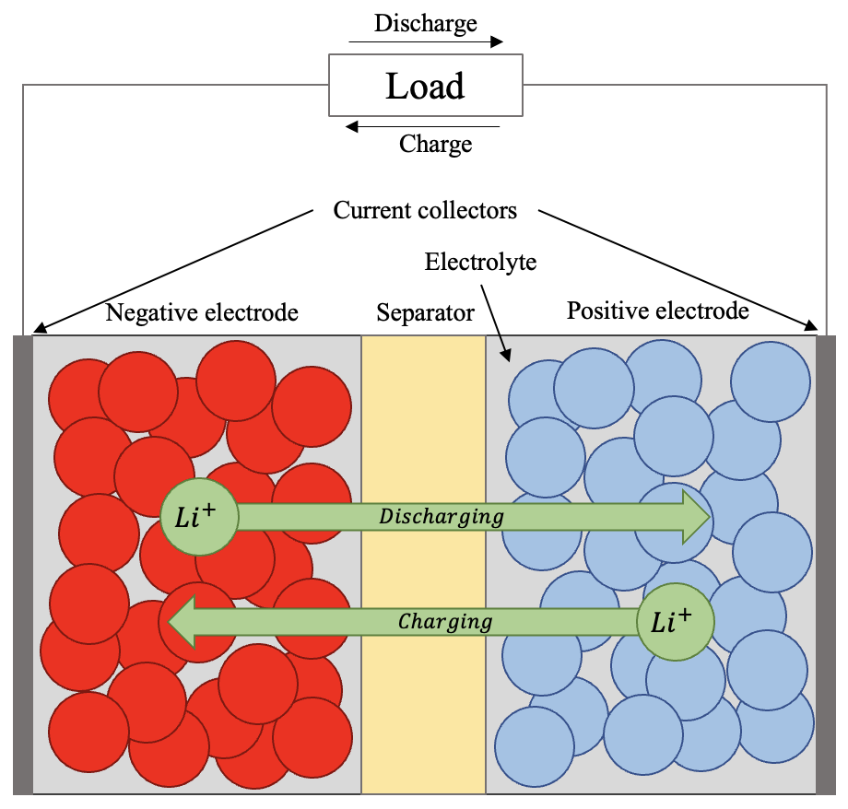
2. Lithium-Ion Battery Cell Model
Basics of Lithium-Ion Batteries
The major components of Battery Cell
Positive Electrode
Negative Electrode
Electrolyte
Separator
Current Collector
Battery Cell Components
Charge: Lithium ions deintercalate from Neg. Electrode and intercalate into Pos. Electrode
Discharge: Lithium ions deintercalate from Pos. Electrode and intercalate into Neg. Electrode
6
Notes:
Next is the is the lithium-ion battery cell model
First, I’ll talk about the components of the battery cell.
As you can see in the Figure (click), there are five major components of the Battery cell. Positive electrode, Negative electrode, electrolyte, Separator and current collector.
Base on this composition I’ll explain the battery cell charge and discharge dynamics.
During the battery charge, the lithium-ions deintercalate from positive electrode’s particles and move through the electrolyte and then intercalate to the negative electrode’s particles. During this process, separator prevents electrons from flowing directly through electrodes and the current is produced depending on the electrons go through the external circuit. From these consequences, the voltage difference occurs between the electrodes. Also, the opposite occurs during discharge. This can be modeled as a spherical diffusion process which I will explain afterward.

Slide 8
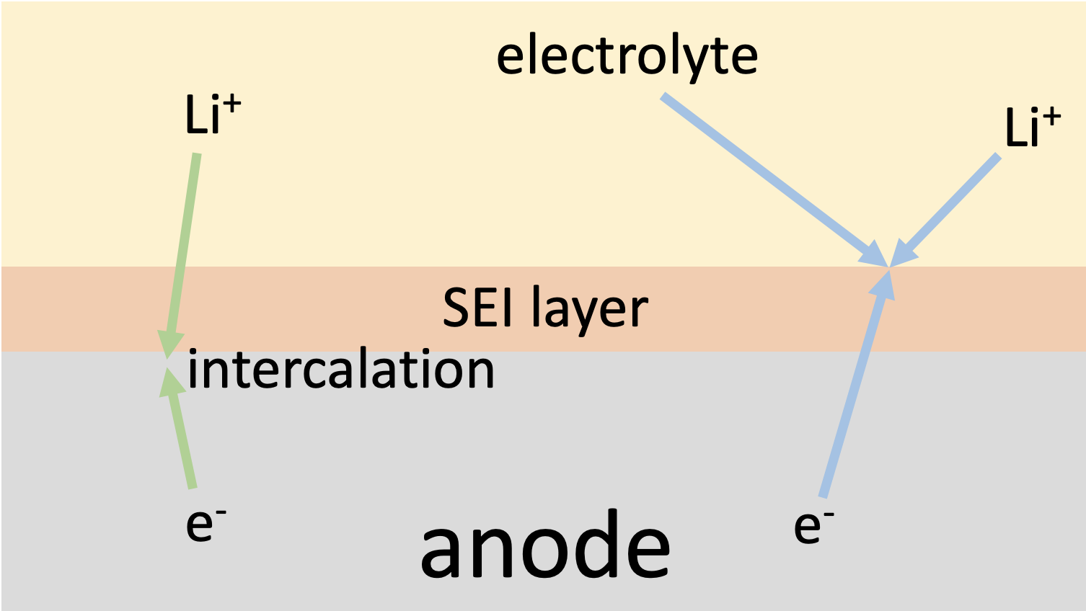
2. Lithium-Ion Battery Cell Model
Basics of Lithium-Ion Batteries
The solid electrolyte interphase (SEI) layer deposited on the active material surface of the anode
Initial formation of the SEI layer acts as a protective barrier between the anode and electrolyte to maintain stability
The continued growth of the SEI layer leads to the capacity and power fade of the battery
7
Notes:
Degradation occurs due to several
Dominant
How
Initial formation
Capacity fade

Slide 9
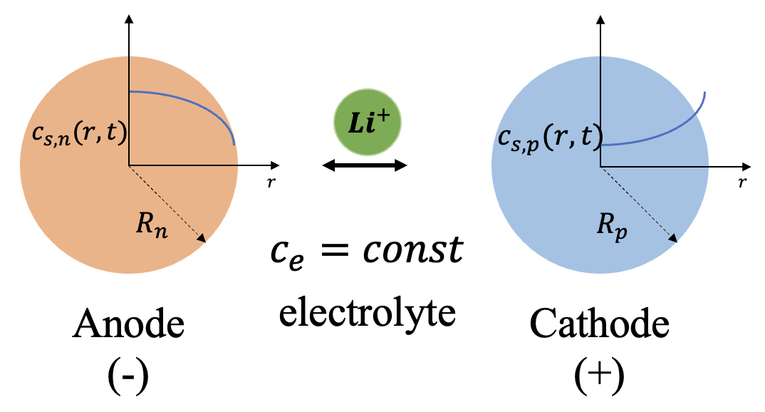
2. Lithium-Ion Battery Cell Model
Single Particle Model (SPM)
The single particle model is a common type of physics-based model which is a simplification of 1D formulation for a lithium-ion battery
Major assumptions of the SPM
Electrodes are composed of spherical particles with a uniform current distribution
Electrolyte dynamic is negligible
Single Particle Model of Lithium-Ion Battery
8
Notes:
it consequently reduces the computational cost and can describe the internal electrochemical states of the battery.

Slide 10
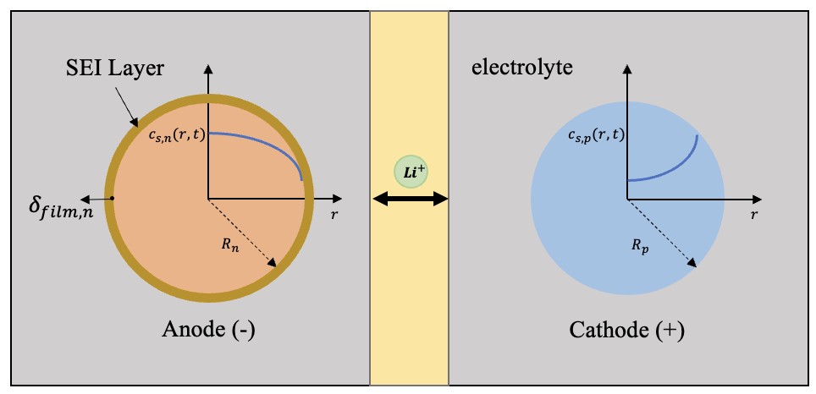
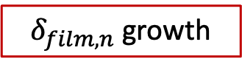
2. Lithium-Ion Battery Cell Model
Single Particle Model (SPM)
Single Particle Model of Lithium-Ion Battery with SEI layer
The SEI layer is formed on the anode surface by occurring the side reaction with lithium-ions and electrolytes.
Active material loss
Resistance of the film layer increase
$δ_{film,n}$ growth
9
Notes:
In this slide I'll explain about the battery degradtion.
The sei layer which typically forms at the negative electrode during recharging makes battery lose the lithium which is the most common and fundamental source of capacity fade in Lithium-ion battery.
So, if the sei layer thickness is getting thicker, the battery cell loses the active material, the internal impedance of the battery would increase, and the resistance of the film layer would increase.
Of course, the sei layer formed on the cathode. However,(click) it is relatively smaller than the anode layer so I focused on the degradation of the anode.

Slide 11
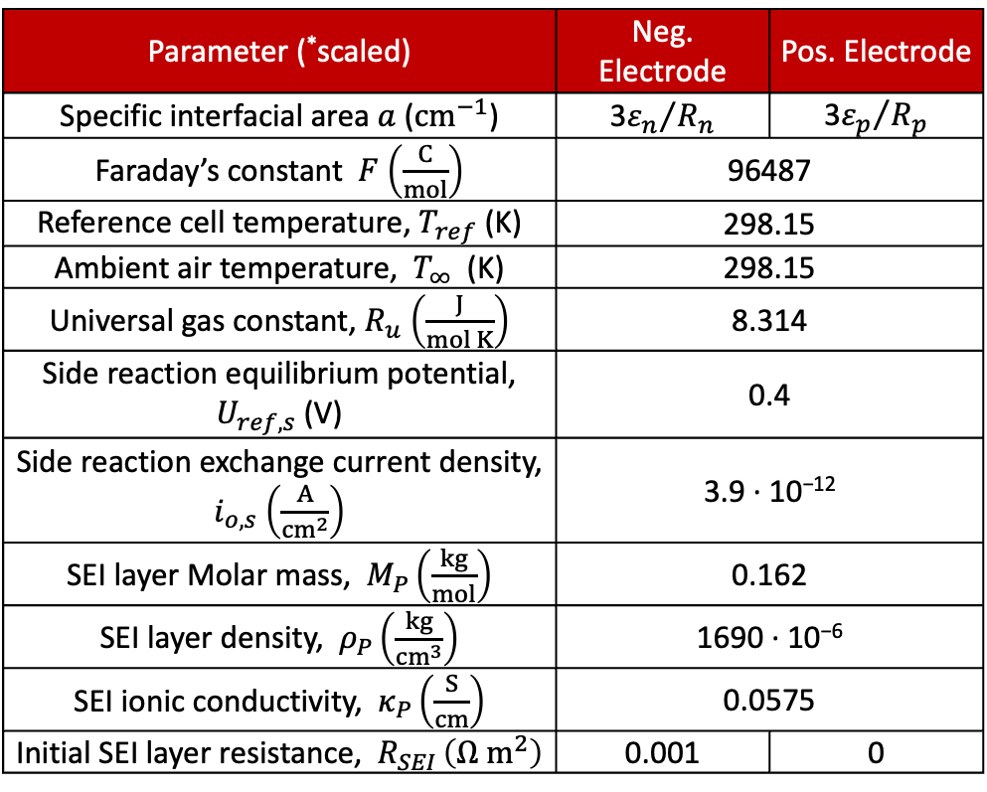
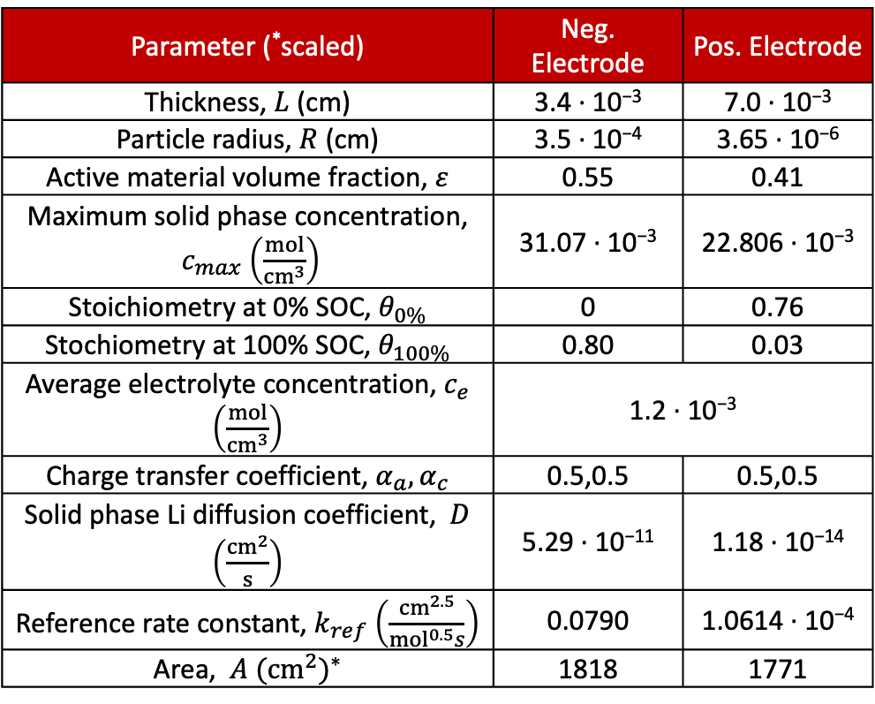
2. Lithium-Ion Battery Cell Model
Single Particle Model (SPM)
Parameter (*scaled) | Neg. Electrode | Pos. Electrode
Thickness, $L$ (cm) | 3.4 · 10⁻³ | 7.0 · 10⁻³
Particle radius, $R$ (cm) | 3.5 · 10⁻⁴ | 3.65 · 10⁻⁶
Active material volume fraction, $ε$ | 0.55 | 0.41
Maximum solid phase concentration, $c_{max}$ $\left(\frac{mol}{{cm}^{3}}\right)$ | 31.07 · 10⁻³ | 22.806 · 10⁻³
Stoichiometry at 0% SOC, $θ_{0\%}$ | 0 | 0.76
Stochiometry at 100% SOC, $θ_{100\%}$ | 0.80 | 0.03
Average electrolyte concentration, $c_{e}$ $\left(\frac{mol}{{cm}^{3}}\right)$ | 1.2 · 10⁻³
Charge transfer coefficient, $α_{a}, α_{c}$ | 0.5,0.5 | 0.5,0.5
Solid phase Li diffusion coefficient, $D$ $\left(\frac{{cm}^{2}}{s}\right)$ | 5.29 · 10⁻¹¹ | 1.18 · 10⁻¹⁴
Reference rate constant, $k_{ref}$ $\left(\frac{{cm}^{2.5}}{{mol}^{0.5}s}\right)$ | 0.0790 | 1.0614 · 10⁻⁴
Area, $A$ ${({cm}^{2})}^{∗}$ | 1818 | 1771
Parameter (*scaled) | Neg. Electrode | Pos. Electrode
Specific interfacial area $a$ (${cm}^{−1}$) | 3${ε_{n}}/{R_{n}}$ | 3${ε_{p}}/{R_{p}}$
Faraday’s constant $F$ $\left(\frac{C}{mol}\right)$ | 96487
Reference cell temperature, $T_{ref}$ (K) | 298.15
Ambient air temperature, $T_{∞}$ (K) | 298.15
Universal gas constant, $R_{u}$ $\left(\frac{J}{mol K}\right)$ | 8.314
Side reaction equilibrium potential, $U_{ref,s}$ (V) | 0.4
Side reaction exchange current density, $i_{o,s}$ $\left(\frac{A}{{cm}^{2}}\right)$ | 3.9 · 10⁻¹²
SEI layer Molar mass, $M_{P}$ $\left(\frac{kg}{mol}\right)$ | 0.162
SEI layer density, $ρ_{P}$ $\left(\frac{kg}{{cm}^{3}}\right)$ | 1690 · 10⁻⁶
SEI ionic conductivity, $κ_{P}$ $\left(\frac{S}{cm}\right)$ | 0.0575
Initial SEI layer resistance, $R_{SEI}$ $\left(Ω{ m}^{2}\right)$ | 0.001 | 0
10

Slide 12
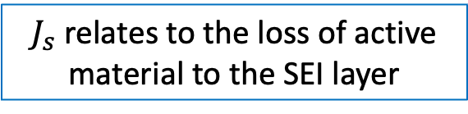

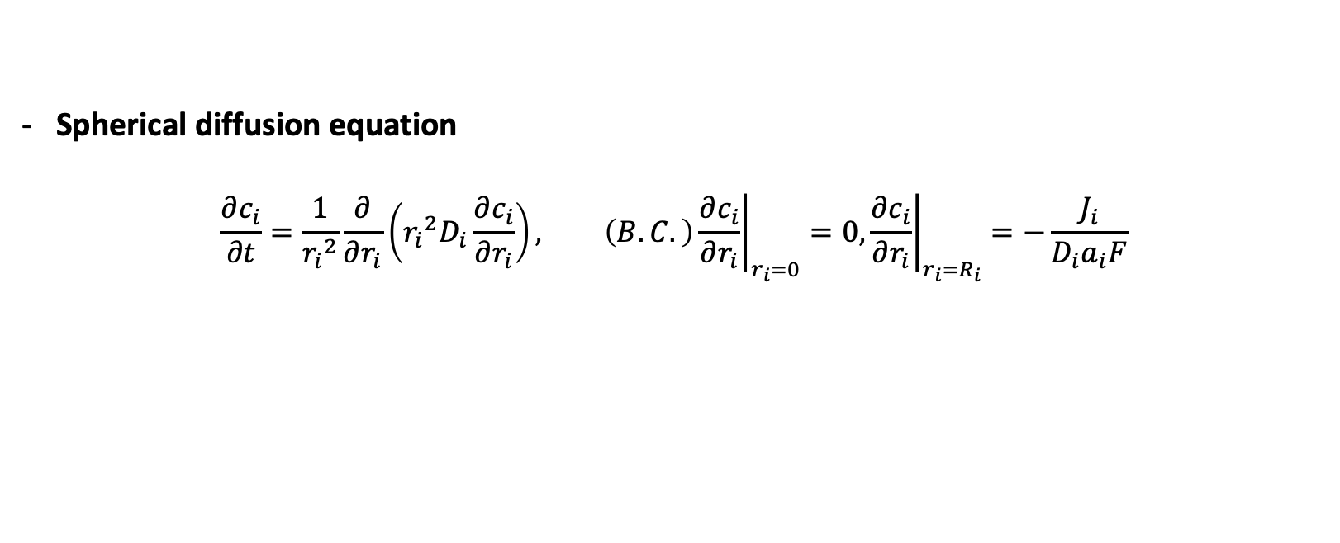
2. Lithium-Ion Battery Cell Model
Single Particle Model (SPM)
Spherical diffusion equation
$$\frac{∂c_{i}}{∂t}=\frac{1}{{r_{i}}^{2}}\frac{∂}{∂r_{i}}\left({r_{i}}^{2}D_{i}\frac{∂c_{i}}{∂r_{i}}\right), \left(B.C.\right){\left.\frac{∂c_{i}}{∂r_{i}}\right|}_{r_{i}=0}=0,{\left.\frac{∂c_{i}}{∂r_{i}}\right|}_{r_{i}=R_{i}}=−\frac{J_{i}}{{D_{i}a}_{i}F}$$
→ The process of lithium ions intercalating and deintercalating from the electrodes is
represented by spherical diffusion
Current Density
$$J_{tot,n}=J_{n}+J_{s}=\frac{I}{A_{n}L_{n}}$$
$$J_{tot,p}=J_{p}=−\frac{I}{A_{p}L_{p}}$$
$J_{s}$ relates to the loss of active material to the SEI layer
11
Notes:
For the case of a spherical particle, the intercalation of lithium ions in the solid phase is modeled as a process due to diffusion. Diffusion governs the concentration within each electrode expressed as the spherical diffusion equation with two boundary conditions which are at the center of the sphere and surface of the sphere.
As I said before in the introduction slide, one of the objectives of this presentation is to figure out how much degradation occurred in the battery cell. So as you can see in the negative electrode current density equation (click) there is a side reaction current density (click) which is one of the important variables in the degradation that relates to the loss of active material to the sei layer. I’ll explain this in detail next further slides

Slide 13
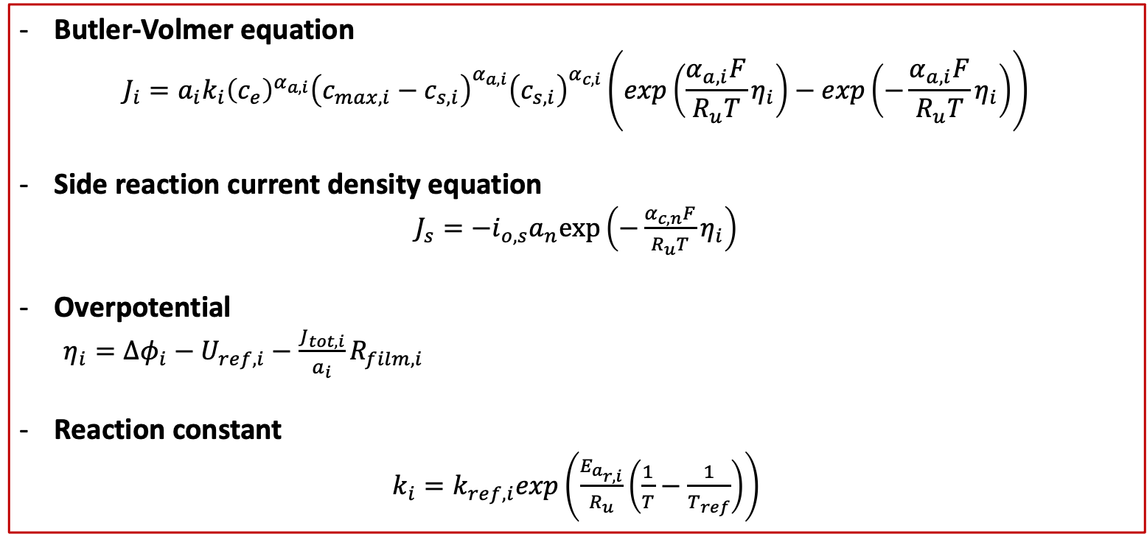
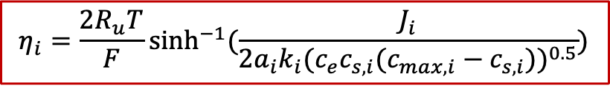
2. Lithium-Ion Battery Cell Model
Single Particle Model (SPM)
Butler-Volmer equation
$$J_{i}=a_{i}k_{i}{\left(c_{e}\right)}^{α_{a,i}}{\left(c_{max,i}−c_{s,i}\right)}^{α_{a,i}}{\left(c_{s,i}\right)}^{α_{c,i}}\left(exp\left(\frac{α_{a,i}F}{R_{u}T}η_{i}\right)−exp\left(−\frac{α_{a,i}F}{R_{u}T}η_{i}\right)\right)$$
Side reaction current density equation
$J_{s}=−i_{o,s}a_{n}exp\left(−\frac{α_{c,n}F}{R_{u}T}η_{i}\right)$
Overpotential
$η_{i}=∆φ_{i}−U_{ref,i}−\frac{J_{tot,i}}{a_{i}}R_{film,i}$
Reaction constant
$k_{i}=k_{ref,i}exp\left(\frac{E_{a_{r,i}}}{R_{u}}\left(\frac{1}{T}−\frac{1}{T_{ref}}\right)\right)$
$$η_{i}=\frac{2R_{u}T}{F}\sinh^{−1}{(\frac{J_{i}}{2a_{i}k_{i}{(c_{e}c_{s,i}(c_{max,i}−c_{s,i}))}^{0.5}})}$$
12
Notes:
Each electrode produces a voltage that depends nonlinearly on the surface concentration of that respective electrode.
The nonlinear function is the reference potential of the electrode for the positive electrode, and for the negative electrode.
The difference in potentials between the electrolyte and the electrodes drives the current through the battery. The Butler-Volmer equation expresses how this potential difference relates to the current.
This is the reduced model of overpotential. This can be calculated by combining Butler volmer equation and current density equation. From the reduced model of overpotential, we can figure out that the overpotential is a direct function of the input current and surface concentration.

Slide 14
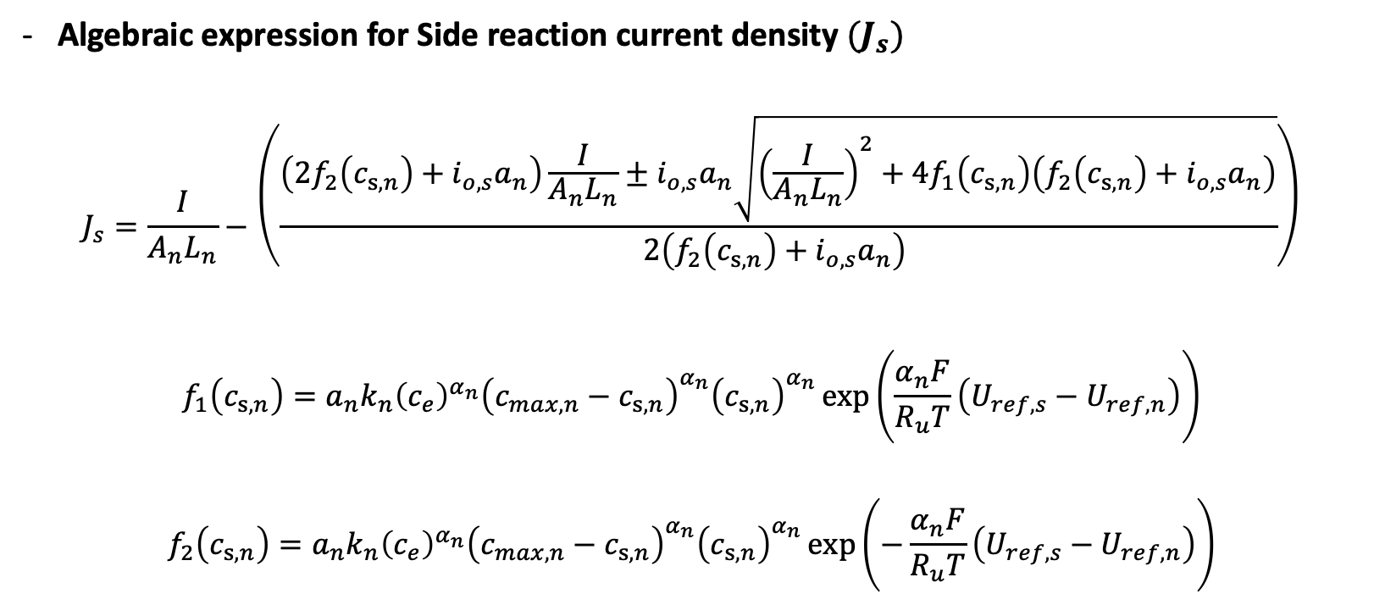
2. Lithium-Ion Battery Cell Model
Single Particle Model (SPM)
Algebraic expression for Side reaction current density ${(J}_{s})$
$$J_{s}=\frac{I}{A_{n}L_{n}}−\left(\frac{\left(2f_{2}\left(c_{s,n}\right)+i_{o,s}a_{n}\right)\frac{I}{A_{n}L_{n}}±i_{o,s}a_{n}\sqrt{{\left(\frac{I}{A_{n}L_{n}}\right)}^{2}+4f_{1}\left(c_{s,n}\right)\left(f_{2}\left(c_{s,n}\right)+i_{o,s}a_{n}\right)}}{2\left(f_{2}\left(c_{s,n}\right)+i_{o,s}a_{n}\right) }\right)$$
$$f_{1}\left(c_{s,n}\right)=a_{n}k_{n}{\left(c_{e}\right)}^{α_{n}}{\left(c_{max,n}−c_{s,n}\right)}^{α_{n}}{\left(c_{s,n}\right)}^{α_{n}}\exp\left(\frac{α_{n}F}{R_{u}T}\left(U_{ref,s}−U_{ref,n}\right)\right)$$
$$f_{2}\left(c_{s,n}\right)=a_{n}k_{n}{\left(c_{e}\right)}^{α_{n}}{\left(c_{max,n}−c_{s,n}\right)}^{α_{n}}{\left(c_{s,n}\right)}^{α_{n}}\exp\left(−\frac{α_{n}F}{R_{u}T}\left(U_{ref,s}−U_{ref,n}\right)\right)$$
→ $J_{s}$ is determined as above equation algebraically which is a function of negative surface concentration ($c_{s,n}$) and input current ($I$).
→ $J_{s}(c_{s,n},I)$
13
Notes:
To figure out the side reaction current density through the simulation and to figure out the negative surface concentration in the battery cell with degradation by using the side reaction current density
we should solve the side reaction current density as a function of surface concentration and current from the bulter volmer equation.
So the final algebraic expression for side reaction current density which we solved is this equation (click) it is determined algebraically by using overpotential equations and negative reference potential equations.
This complex non-linear equation is combined with the battery cell model which is modeled by the finite difference method. I’ll explain this in detail next further slides.

Slide 15
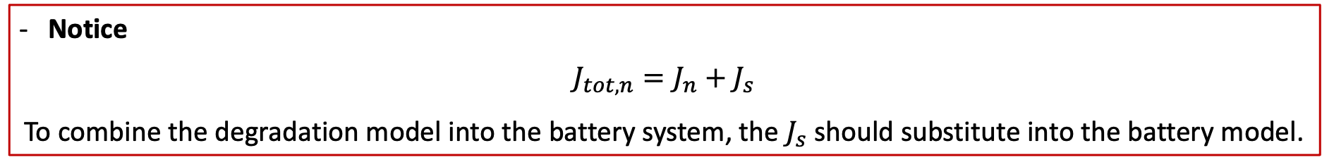
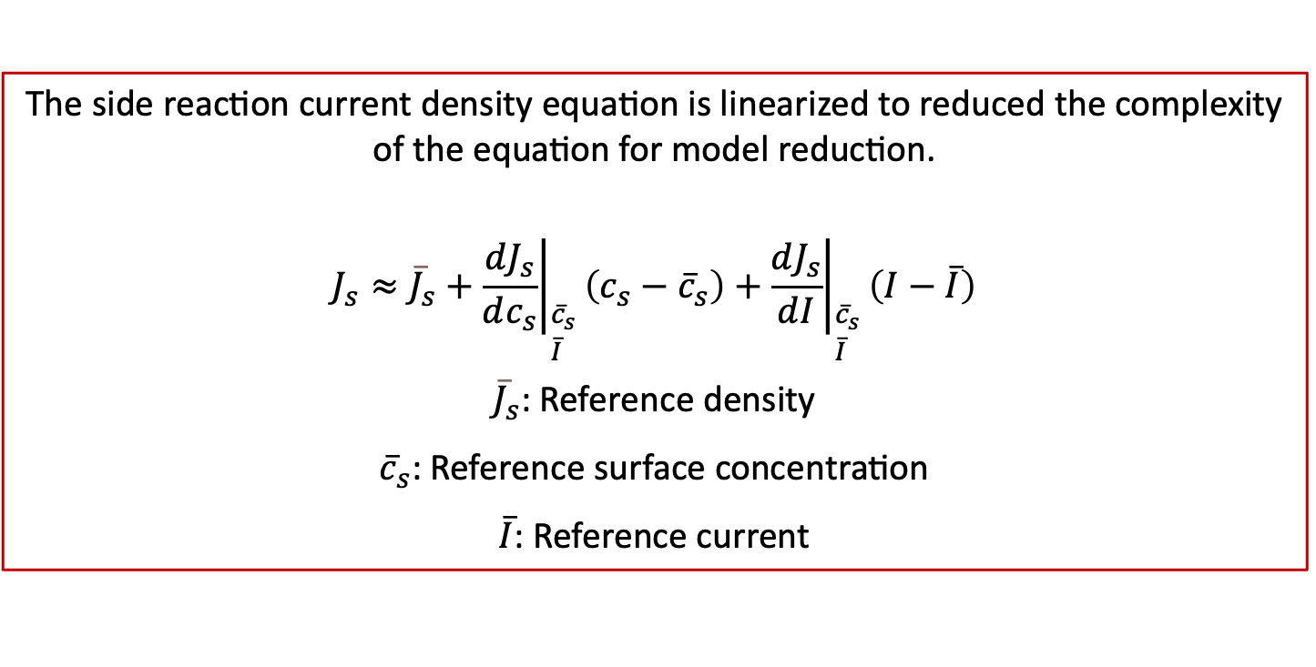
2. Lithium-Ion Battery Cell Model
Single Particle Model (SPM)
Notice
$$J_{tot,n}=J_{n}+J_{s}$$
To combine the degradation model into the battery system, the $J_{s}$ should substitute into the battery model.
The side reaction current density equation is linearized to reduced the complexity of the equation for model reduction.
$$J_{s}≈{\overline{J}}_{s}+{\left.\left.\frac{dJ_{s}}{dc_{s}}\right.\right|}_{\begin{aligned}&{\overline{c}}_{s} \\ &\overline{I}\end{aligned}}\left(c_{s}−{\overline{c}}_{s}\right)+{\left.\left.\frac{dJ_{s}}{dI}\right.\right|}_{\begin{aligned}&{\overline{c}}_{s} \\ &\overline{I}\end{aligned}}\left(I−\overline{I}\right)$$
${\overline{J}}_{s}$: Reference density
${\overline{c}}_{s}$: Reference surface concentration
$\overline{I}$: Reference current
14
Notes:
To figure out the side reaction current density through the simulation and to figure out the negative surface concentration in the battery cell with degradation by using the side reaction current density
we should solve the side reaction current density as a function of surface concentration and current from the bulter volmer equation.
So the final algebraic expression for side reaction current density which we solved is this equation (click) it is determined algebraically by using overpotential equations and negative reference potential equations.
This complex non-linear equation is combined with the battery cell model which is modeled by the finite difference method. I’ll explain this in detail next further slides.

Slide 16
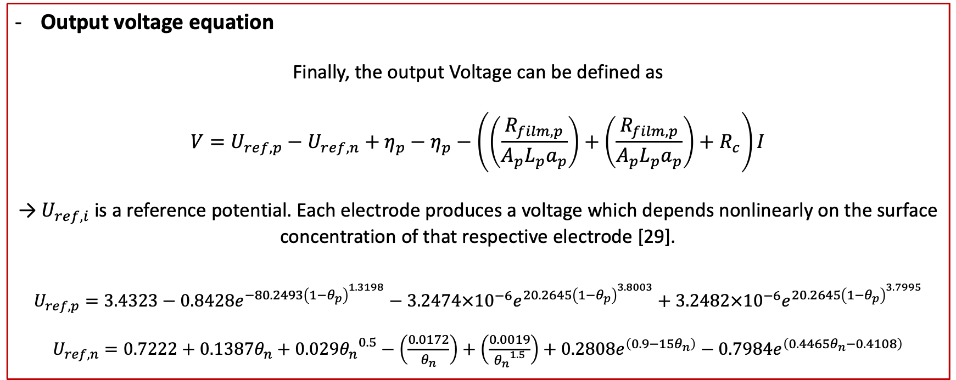
2. Lithium-Ion Battery Cell Model
Single Particle Model (SPM)
Output voltage equation
Finally, the output Voltage can be defined as
$$V=U_{ref,p}−U_{ref,n}+η_{p}−η_{p}−\left(\left(\frac{R_{film,p}}{A_{p}L_{p}a_{p}}\right)+\left(\frac{R_{film,p}}{A_{p}L_{p}a_{p}}\right)+R_{c}\right)I$$
→ $U_{ref,i}$ is a reference potential. Each electrode produces a voltage which depends nonlinearly on the surface concentration of that respective electrode [29].
$$U_{ref,p}=3.4323−0.8428e^{−80.2493{\left(1−θ_{p}\right)}^{1.3198}}−3.2474×{10}^{−6}e^{20.2645{\left(1−θ_{p}\right)}^{3.8003}}+3.2482×{10}^{−6}e^{20.2645{\left(1−θ_{p}\right)}^{3.7995}}$$
$U_{ref,n}=0.7222+0.1387θ_{n}+0.029{θ_{n}}^{0.5}−\left(\frac{0.0172}{θ_{n}}\right)+\left(\frac{0.0019}{{θ_{n}}^{1.5}}\right)+0.2808e^{\left(0.9−15θ_{n}\right)}−0.7984e^{\left(0.4465θ_{n}−0.4108\right)}$
15
Notes:
This is the final equation of the output voltage.
Let’s remind the single particle model figure. I discussed that we need to consider these components to determine the output voltage.
I could complete the output voltage equation from variables which I got through the model reduction.
In the first term of the equation, reference potentials are functions of the surface concentrations and this can be computed with the state space model which I got before. Also, in the second term the overpotential is calculated with reduced order model equation. And additional resistance parts can be calculated with given parameter.

Slide 17
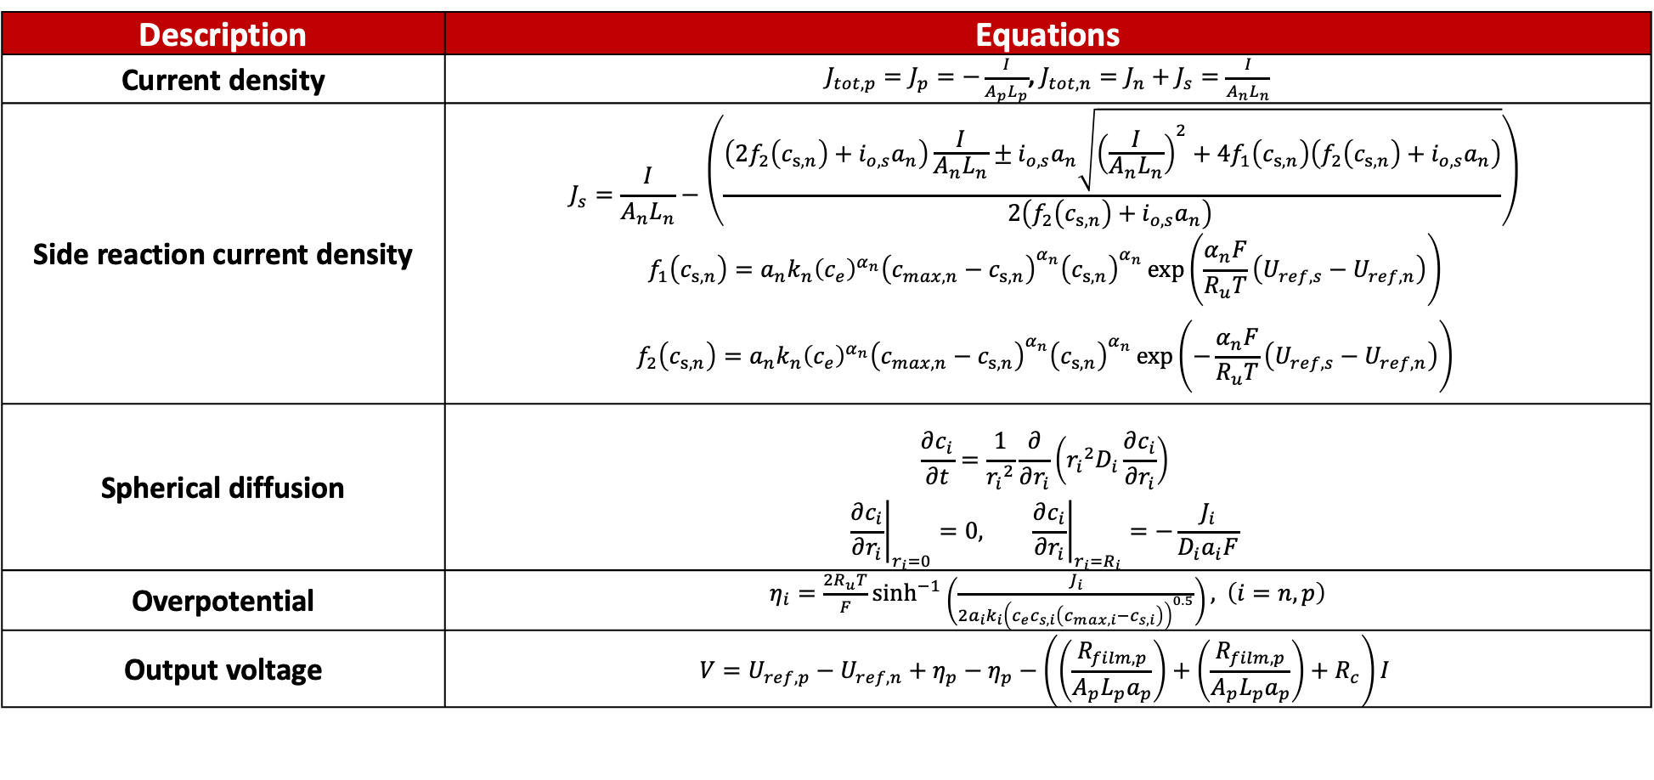
2. Lithium-Ion Battery Cell Model
Single Particle Model (SPM)
Description | Equations
Current density | $J_{tot,p}=J_{p}=−\frac{I}{A_{p}L_{p}}$, $J_{tot,n}=J_{n}+J_{s}=\frac{I}{A_{n}L_{n}}$
Side reaction current density | $$J_{s}=\frac{I}{A_{n}L_{n}}−\left(\frac{\left(2f_{2}\left(c_{s,n}\right)+i_{o,s}a_{n}\right)\frac{I}{A_{n}L_{n}}±i_{o,s}a_{n}\sqrt{{\left(\frac{I}{A_{n}L_{n}}\right)}^{2}+4f_{1}\left(c_{s,n}\right)\left(f_{2}\left(c_{s,n}\right)+i_{o,s}a_{n}\right)}}{2\left(f_{2}\left(c_{s,n}\right)+i_{o,s}a_{n}\right) }\right)$$ $$f_{1}\left(c_{s,n}\right)=a_{n}k_{n}{\left(c_{e}\right)}^{α_{n}}{\left(c_{max,n}−c_{s,n}\right)}^{α_{n}}{\left(c_{s,n}\right)}^{α_{n}}\exp\left(\frac{α_{n}F}{R_{u}T}\left(U_{ref,s}−U_{ref,n}\right)\right)$$ $$f_{2}\left(c_{s,n}\right)=a_{n}k_{n}{\left(c_{e}\right)}^{α_{n}}{\left(c_{max,n}−c_{s,n}\right)}^{α_{n}}{\left(c_{s,n}\right)}^{α_{n}}\exp\left(−\frac{α_{n}F}{R_{u}T}\left(U_{ref,s}−U_{ref,n}\right)\right)$$
Spherical diffusion | $$\frac{∂c_{i}}{∂t}=\frac{1}{{r_{i}}^{2}}\frac{∂}{∂r_{i}}\left({r_{i}}^{2}D_{i}\frac{∂c_{i}}{∂r_{i}}\right)$$ $${\left.\frac{∂c_{i}}{∂r_{i}}\right|}_{r_{i}=0}=0, {\left.\frac{∂c_{i}}{∂r_{i}}\right|}_{r_{i}=R_{i}}=−\frac{J_{i}}{{D_{i}a}_{i}F}$$
Overpotential | $η_{i}=\frac{2R_{u}T}{F}\sinh^{−1}\left(\frac{J_{i}}{2a_{i}k_{i}{\left(c_{e}c_{s,i}\left(c_{max,i}−c_{s,i}\right)\right)}^{0.5}}\right),$ $\left(i=n,p\right)$
Output voltage | $$V=U_{ref,p}−U_{ref,n}+η_{p}−η_{p}−\left(\left(\frac{R_{film,p}}{A_{p}L_{p}a_{p}}\right)+\left(\frac{R_{film,p}}{A_{p}L_{p}a_{p}}\right)+R_{c}\right)I$$
16
Notes:
To figure out the side reaction current density through the simulation and to figure out the negative surface concentration in the battery cell with degradation by using the side reaction current density
we should solve the side reaction current density as a function of surface concentration and current from the bulter volmer equation.
So the final algebraic expression for side reaction current density which we solved is this equation (click) it is determined algebraically by using overpotential equations and negative reference potential equations.
This complex non-linear equation is combined with the battery cell model which is modeled by the finite difference method. I’ll explain this in detail next further slides.

Slide 18
Introduction
Lithium-Ion Battery Cell Model
Basics of Lithium-Ion Battery
The Single Particle Model
Model Reduction
Baseline Model Reduction Method
Optimization-based Model Reduction Method
Padé Approximation
Simulation and Optimization Setup
Results and Discussion
Conclusion
17

Slide 19
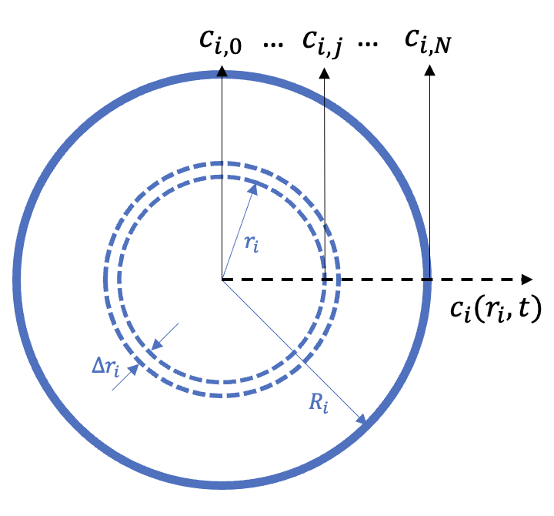
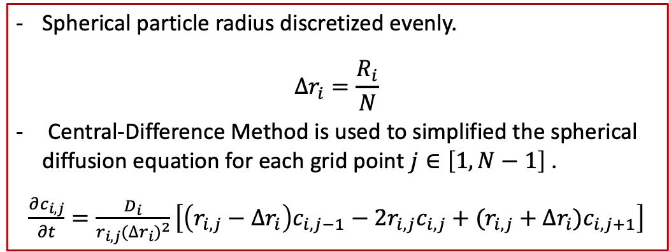
3. Model Reduction
Baseline Model Reduction Method
Finite Difference Method (FDM) is applied to the governing equation to convert the PDEs into ODEs to solve the spherical diffusion equations in the SPM.
→ FDM is used to model the battery cell with a degradation model by discretizing the electrode particle to compute the concentration distribution.
Spherical particle radius discretized evenly.
$$∆r_{i}=\frac{R_{i}}{N}$$
Central-Difference Method is used to simplified the spherical diffusion equation for each grid point $j∈\left[1, N−1\right]$ .
$\frac{∂c_{i,j}}{∂t}=\frac{D_{i}}{r_{i,j}{(∆r_{i})}^{2}}\left[\left(r_{i,j}−∆r_{i}\right)c_{i,j−1}−2r_{i,j}c_{i,j}+(r_{i,j}+∆r_{i})c_{i,j+1}\right]$
Evenly discretized single particle electrode
18
Notes:
Based on the battery dynamics I have been explained, I will explain how I modeled the battery cell.
As I explained briefly in the previous slides, I used the finite difference method to model the battery cell.
So in my research, FDM is applied to the spherical diffusion equation to covert the Partial differential equations into ordinary differential equations to solve numerically.
To be specific, FDM is used to model the battery system to discretize the electrode particle to compute concentration distribution.
In this process, Central difference in FDM is used to convert the complex PDEs of the spherical diffusion equation into ODEs which are expressed as the time derivative of lithium-ion concentration at each node as you can see this equation (click)
and applied the boundary conditions at the center of the particle and surface of the particle However, when you see the boundary condition at the surface of the particle (click), current density exists which contains the side reaction current density in the anode.

Slide 20
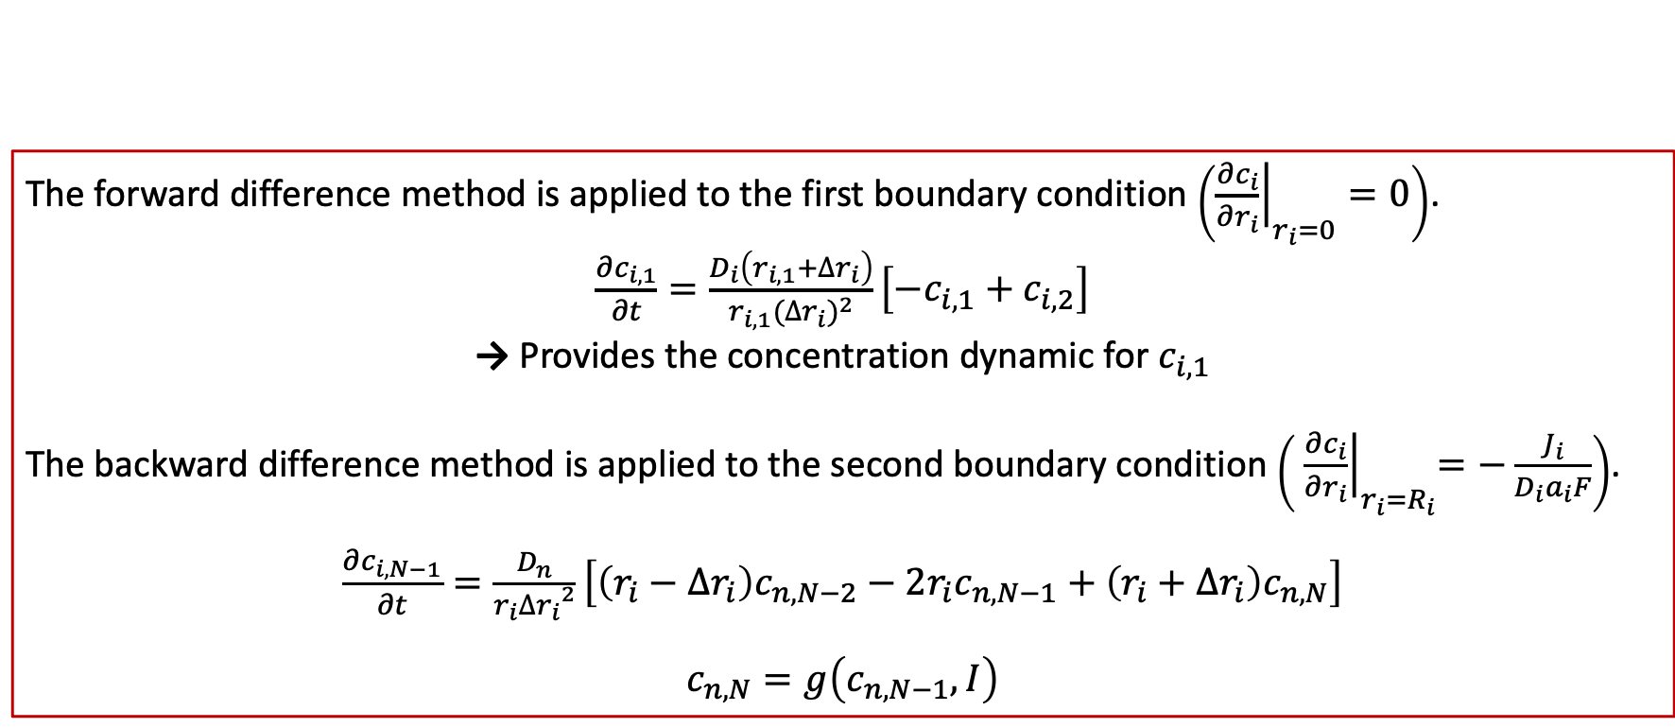
3. Model Reduction
Baseline Model Reduction Method
The forward difference method is applied to the first boundary condition $\left({\left.\frac{∂c_{i}}{∂r_{i}}\right|}_{r_{i}=0}=0\right)$.
$\frac{∂c_{i,1}}{∂t}=\frac{D_{i}\left(r_{i,1}+∆r_{i}\right)}{r_{i,1}{(∆r_{i})}^{2}}\left[−c_{i,1}+c_{i,2}\right]$
→ Provides the concentration dynamic for $c_{i,1}$
The backward difference method is applied to the second boundary condition $\left({ \left.\frac{∂c_{i}}{∂r_{i}}\right|}_{r_{i}=R_{i}}=−\frac{J_{i}}{{D_{i}a}_{i}F}\right)$.
$\frac{∂c_{i,N−1}}{∂t}=\frac{D_{n}}{r_{i}{∆r_{i}}^{2}}\left[\left(r_{i}−∆r_{i}\right)c_{n,N−2}−2r_{i}c_{n,N−1}+\left(r_{i}+∆r_{i}\right)c_{n,N}\right]$
$c_{n,N}=g\left(c_{n,N−1},I\right)$
→ A similar procedure can be applied for the linearized degradation case or the positive electrode dynamics
19
Notes:
Next is how I applied the Js equation directly to figure out the surface concentration at negative electrode.
As we know that Js is really complex nonlinear equation so that another Numerical analysis is required to solve the ODEs obtained from the finite difference method without using the linearized $J_{s}$ equation.
The first thing I did is discretize the ordinary differential equations as this equation (click) to figure out the concentration
at each time step.
Based on this equation and initial conditions, we could get the next time step of concentration notated as k (click)
from the previous time step of concentration notated as k-1 (click).
Next, we should get the negative surface concentration by using the concentration data. However, you can see that the negative surface concentration equation contains total negative current density.
It is too complicated to solve surface concentration, and also it is hard to solve analytically, so we need another numerical method as I explained before.

Slide 21
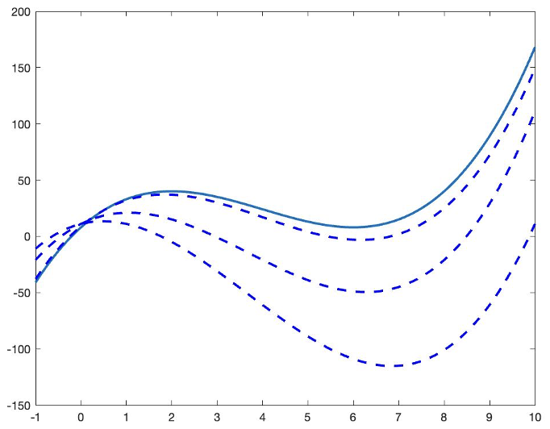
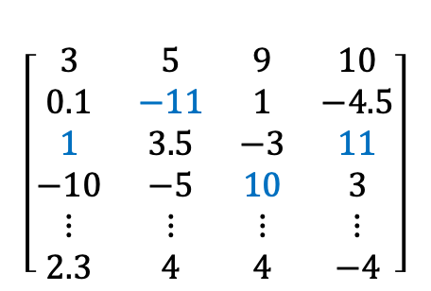
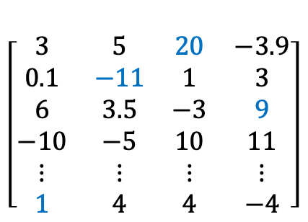
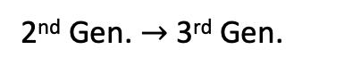
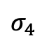
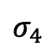
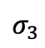
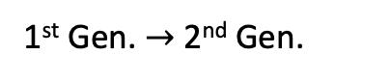
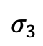
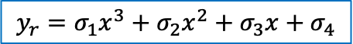
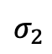
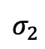
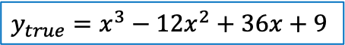
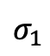
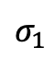
3. Model Reduction
Optimization-Based Model Reduction
The FDM requires a high number of states to accurately capture diffusion dynamics
The optimization-based procedure is used to reduce the model’s complexity
$$y_{true}=x^{3}−12x^{2}+36x+9$$
Genetic Algorithm (GA)
Initial Population
Second Population
$$σ_{1}$$
$$σ_{2}$$
$$σ_{3}$$
$$σ_{4}$$
$$σ_{1}$$
$$σ_{2}$$
$$σ_{3}$$
$$σ_{4}$$
$$\left[\begin{matrix}3 & 5 & 9 & 10 \\ 0.1 & −11 & 1 & −4.5 \\ 1 & 3.5 & −3 & 11 \\ −10 & −5 & 10 & 3 \\ ⋮ & ⋮ & ⋮ & ⋮ \\ 2.3 & 4 & 4 & −4\end{matrix}\right]$$
$$\left[\begin{matrix}3 & 5 & 20 & −3.9 \\ 0.1 & −11 & 1 & 3 \\ 6 & 3.5 & −3 & 9 \\ −10 & −5 & 10 & 11 \\ ⋮ & ⋮ & ⋮ & ⋮ \\ 1 & 4 & 4 & −4\end{matrix}\right]$$
2nd Gen. $→$ 3rd Gen.
1st Gen. $→$ 2nd Gen.
$$y_{r}=σ_{1}x^{3}+σ_{2}x^{2}+σ_{3}x+σ_{4}$$
20
Notes:
In the previous slides, one of the assumptions in the single-particle model was each electrode is composed of a spherical particle.
For the case of a spherical particle, the intercalation of lithium ions in the solid phase is modeled as a process due to diffusion.
So, base on the Spherical diffusion equation and Current density we could derive the surface concentration by using pade approximation of the model reduction method. I’ll explain it in detail in further slides.
So, the reason why we need to figure out the surface concentration is the Surface concentration affects the electrochemical reaction driving intercalation in the battery and each electrode produces a voltage that depends nonlinearly on the surface concentration of that respective electrode.

Slide 22
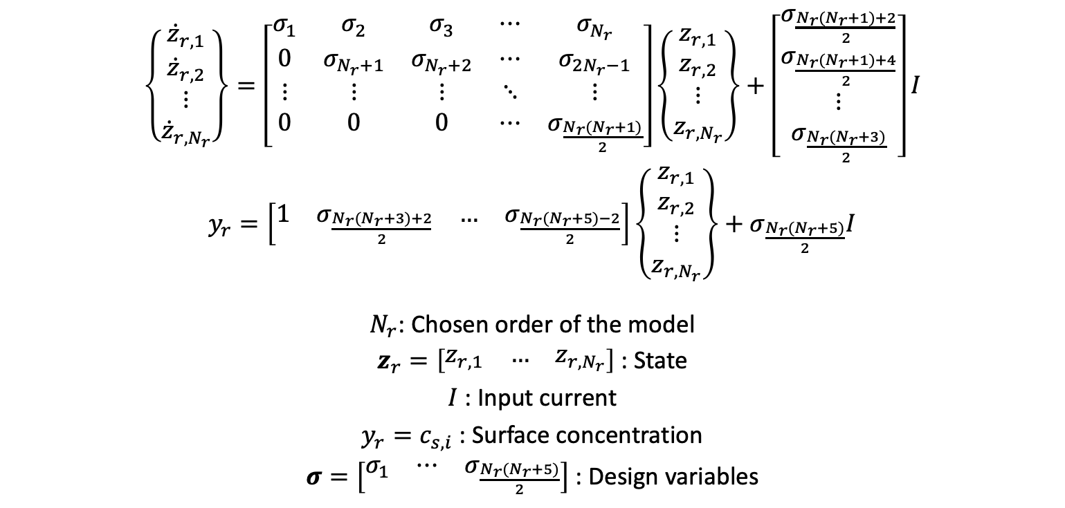
3. Model Reduction
Optimization-Based Model Reduction
To develop a reduced-order model using an optimization-based approach, the following steps are applied.
A state space model is selected
Constraints
The objective function is defined
The optimization problem is
formulated and solved
$\left\{\begin{matrix}{\dot{z}}_{r,1} \\ {\dot{z}}_{r,2} \\ \begin{aligned}⋮ \\ {\dot{z}}_{r,N_{r}}\end{aligned}\end{matrix}\right\}=\left[\begin{matrix}σ_{1} & σ_{2} & σ_{3} & ⋯ & σ_{N_{r}} \\ 0 & σ_{N_{r}+1} & σ_{N_{r}+2} & ⋯ & σ_{2N_{r}−1} \\ ⋮ & ⋮ & ⋮ & ⋱ & ⋮ \\ 0 & 0 & 0 & ⋯ & σ_{\frac{N_{r}(N_{r}+1)}{2}}\end{matrix}\right]\left\{\begin{matrix}z_{r,1} \\ z_{r,2} \\ \begin{aligned}⋮ \\ z_{r,N_{r}}\end{aligned}\end{matrix}\right\}+\left[\begin{matrix}σ_{\frac{N_{r}(N_{r}+1)+2}{2}} \\ σ_{\frac{N_{r}(N_{r}+1)+4}{2}} \\ \begin{aligned}⋮ \\ σ_{\frac{N_{r}(N_{r}+3)}{2}}\end{aligned}\end{matrix}\right]I$
$y_{r}=\left[\begin{matrix}1 & σ_{\frac{N_{r}(N_{r}+3)+2}{2}} & … & σ_{\frac{N_{r}(N_{r}+5)−2}{2}}\end{matrix}\right]\left\{\begin{matrix}z_{r,1} \\ z_{r,2} \\ \begin{aligned}⋮ \\ z_{r,N_{r}}\end{aligned}\end{matrix}\right\}+σ_{\frac{N_{r}(N_{r}+5)}{2}}I$
$N_{r}$: Chosen order of the model
$z_{r}=\left[\begin{matrix}z_{r,1} & … & z_{r,N_{r}}\end{matrix}\right]$ : State
$I$ : Input current
$y_{r}=c_{s,i}$ : Surface concentration
$σ=\left[\begin{matrix}σ_{1} & ⋯ & σ_{\frac{N_{r}(N_{r}+5)}{2}}\end{matrix}\right]$ : Design variables
21
Notes:
In the previous slides, one of the assumptions in the single-particle model was each electrode is composed of a spherical particle.
For the case of a spherical particle, the intercalation of lithium ions in the solid phase is modeled as a process due to diffusion.
So, base on the Spherical diffusion equation and Current density we could derive the surface concentration by using pade approximation of the model reduction method. I’ll explain it in detail in further slides.
So, the reason why we need to figure out the surface concentration is the Surface concentration affects the electrochemical reaction driving intercalation in the battery and each electrode produces a voltage that depends nonlinearly on the surface concentration of that respective electrode.

Slide 23
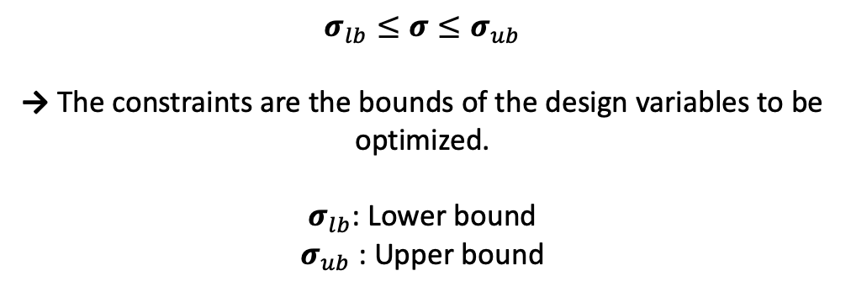
3. Model Reduction
Optimization-Based Model Reduction
A state space model is selected
Constraints
The objective function is defined
The optimization problem is
formulated and solved
$σ_{lb}≤σ≤σ_{ub}$
→ The constraints are the bounds of the design variables to be optimized.
$σ_{lb}$: Lower bound
$σ_{ub}$ : Upper bound
22
Notes:
In the previous slides, one of the assumptions in the single-particle model was each electrode is composed of a spherical particle.
For the case of a spherical particle, the intercalation of lithium ions in the solid phase is modeled as a process due to diffusion.
So, base on the Spherical diffusion equation and Current density we could derive the surface concentration by using pade approximation of the model reduction method. I’ll explain it in detail in further slides.
So, the reason why we need to figure out the surface concentration is the Surface concentration affects the electrochemical reaction driving intercalation in the battery and each electrode produces a voltage that depends nonlinearly on the surface concentration of that respective electrode.

Slide 24
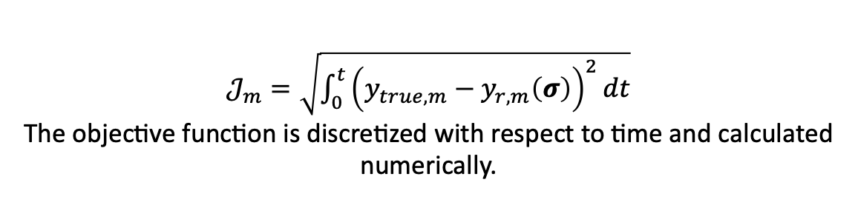
3. Model Reduction
Optimization-Based Model Reduction
Output of the true data
Output of the reduced-order model data
A state space model is selected
Constraints
The objective function is defined
The optimization problem is
formulated and solved
$𝒥_{m}=\sqrt{\int_{0}^{t}{{\left(y_{true,m}−y_{r,m}\left(σ\right)\right)}^{2}dt}}$
The objective function is discretized with respect to time and calculated numerically.
23
Notes:
In the previous slides, one of the assumptions in the single-particle model was each electrode is composed of a spherical particle.
For the case of a spherical particle, the intercalation of lithium ions in the solid phase is modeled as a process due to diffusion.
So, base on the Spherical diffusion equation and Current density we could derive the surface concentration by using pade approximation of the model reduction method. I’ll explain it in detail in further slides.
So, the reason why we need to figure out the surface concentration is the Surface concentration affects the electrochemical reaction driving intercalation in the battery and each electrode produces a voltage that depends nonlinearly on the surface concentration of that respective electrode.

Slide 25
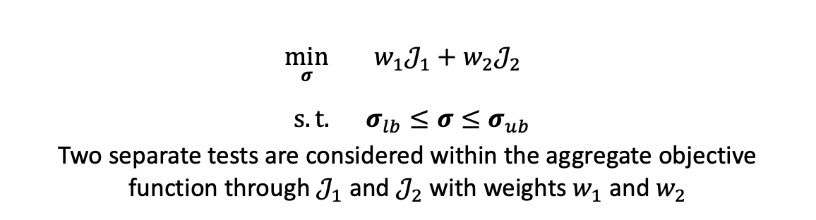
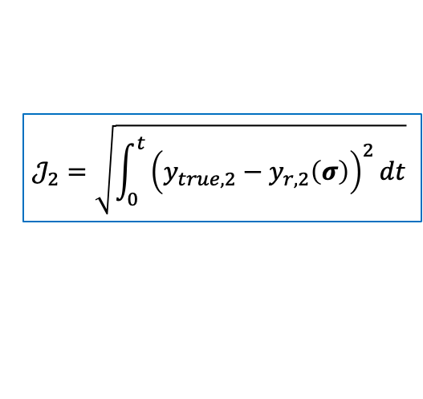
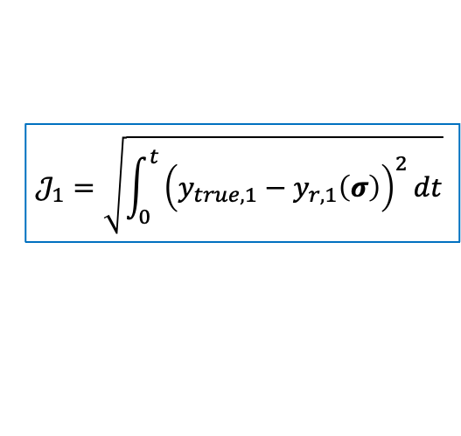
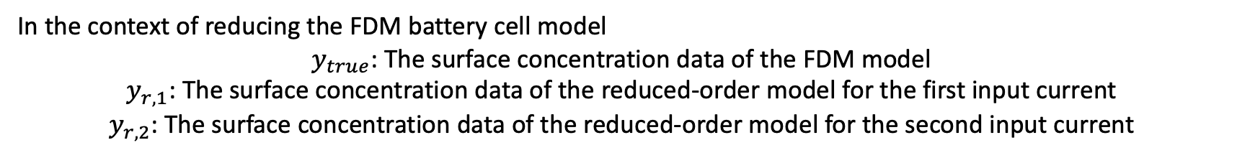
3. Model Reduction
Optimization-Based Model Reduction
$$𝒥_{1}=\sqrt{\int_{0}^{t}{{\left(y_{true,1}−y_{r,1}\left(σ\right)\right)}^{2}dt}}$$
$$𝒥_{2}=\sqrt{\int_{0}^{t}{{\left(y_{true,2}−y_{r,2}\left(σ\right)\right)}^{2}dt}}$$
A state space model is selected
Constraints
The objective function is defined
The optimization problem is
formulated and solved
$\begin{matrix}\min_{σ}{ } & w_{1}𝒥_{1}+w_{2}𝒥_{2} \\ & \\ s.t. & σ_{lb}≤σ≤σ_{ub}\end{matrix}$
Two separate tests are considered within the aggregate objective function through $𝒥_{1}$ and $𝒥_{2}$ with weights $w_{1}$ and $w_{2}$
In the context of reducing the FDM battery cell model
$y_{true}$: The surface concentration data of the FDM model
$y_{r,1}$: The surface concentration data of the reduced-order model for the first input current
$y_{r,2}$: The surface concentration data of the reduced-order model for the second input current
24
Notes:
In the previous slides, one of the assumptions in the single-particle model was each electrode is composed of a spherical particle.
For the case of a spherical particle, the intercalation of lithium ions in the solid phase is modeled as a process due to diffusion.
So, base on the Spherical diffusion equation and Current density we could derive the surface concentration by using pade approximation of the model reduction method. I’ll explain it in detail in further slides.
So, the reason why we need to figure out the surface concentration is the Surface concentration affects the electrochemical reaction driving intercalation in the battery and each electrode produces a voltage that depends nonlinearly on the surface concentration of that respective electrode.

Slide 26
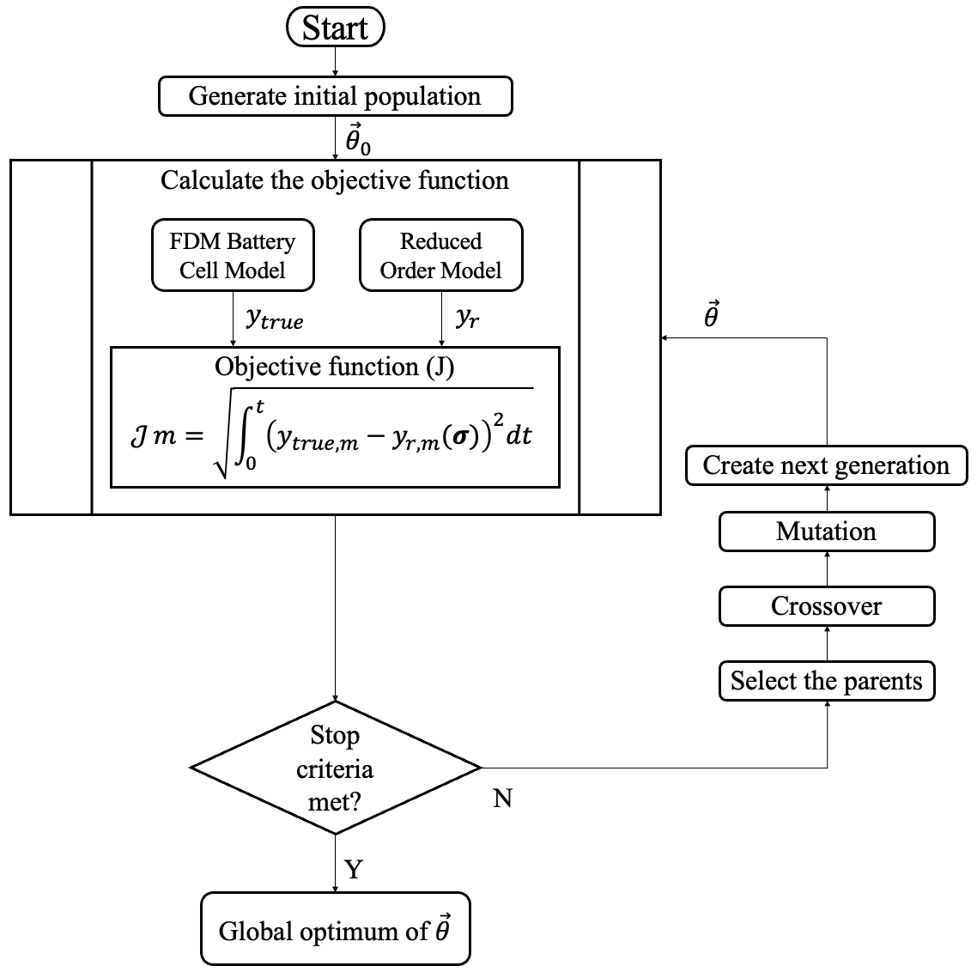
3. Model Reduction
Optimization-Based Model Reduction
The algorithm continues to find superior sets of design variable values by creating the evolutionary generation from the previous population and calculating the objective function.
Process is repeated until the number of generations reaches the maximum number of generations.
25
Notes:
In the previous slides, one of the assumptions in the single-particle model was each electrode is composed of a spherical particle.
For the case of a spherical particle, the intercalation of lithium ions in the solid phase is modeled as a process due to diffusion.
So, base on the Spherical diffusion equation and Current density we could derive the surface concentration by using pade approximation of the model reduction method. I’ll explain it in detail in further slides.
So, the reason why we need to figure out the surface concentration is the Surface concentration affects the electrochemical reaction driving intercalation in the battery and each electrode produces a voltage that depends nonlinearly on the surface concentration of that respective electrode.

Slide 27
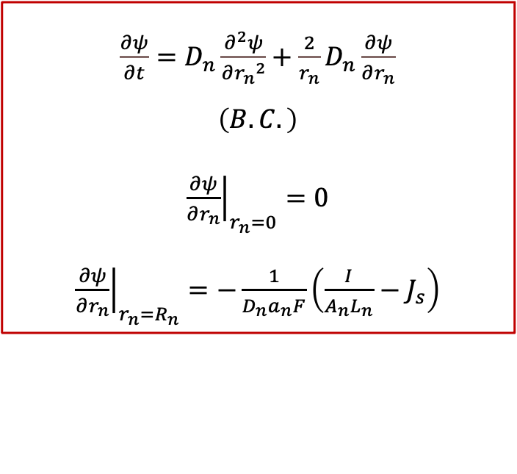
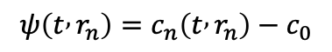
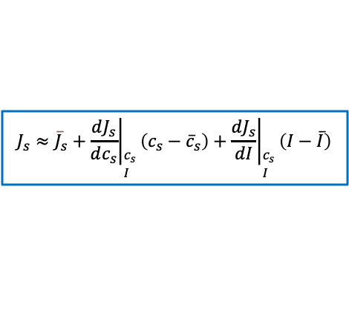
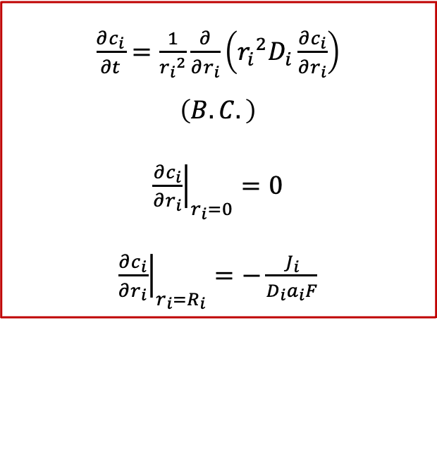
3. Model Reduction
Padé Approximation
As an alternative to the FDM, the Padé approximation can reduce the linearized spherical diffusion equations into a state space model.
To combine the degradation model, unique solution of the Padé approximation is proposed due to the boundary condition of the spherical diffusion equation in the negative electrode.
$\frac{∂c_{i}}{∂t}=\frac{1}{{r_{i}}^{2}}\frac{∂}{∂r_{i}}\left({r_{i}}^{2}D_{i}\frac{∂c_{i}}{∂r_{i}}\right)$
$$\left(B.C.\right)$$
${\left.\frac{∂c_{i}}{∂r_{i}}\right|}_{r_{i}=0}=0$
${\left.\frac{∂c_{i}}{∂r_{i}}\right|}_{r_{i}=R_{i}}=−\frac{J_{i}}{{D_{i}a}_{i}F}$
$\frac{∂ψ}{∂t}=D_{n}\frac{∂^{2}ψ}{∂{r_{n}}^{2}}+\frac{2}{r_{n}}D_{n}\frac{∂ψ}{∂r_{n}}$
$$\left(B.C.\right)$$
${\left.\frac{∂ψ}{∂r_{n}}\right|}_{r_{n}=0}=0$
${\left.\frac{∂ψ}{∂r_{n}}\right|}_{r_{n}=R_{n}}=−\frac{1}{{D_{n}a}_{n}F}\left(\frac{I}{A_{n}L_{n}}−J_{s}\right)$
$$ψ\left(t , r_{n}\right)=c_{n}\left(t , r_{n}\right)−c_{0}$$
Linearized Model
$$J_{s}≈{\overline{J}}_{s}+{\left.\left.\frac{dJ_{s}}{dc_{s}}\right.\right|}_{\begin{aligned}&{\overline{c}}_{s} \\ &\overline{I}\end{aligned}}\left(c_{s}−{\overline{c}}_{s}\right)+{\left.\left.\frac{dJ_{s}}{dI}\right.\right|}_{\begin{aligned}&{\overline{c}}_{s} \\ &\overline{I}\end{aligned}}\left(I−\overline{I}\right)$$
26
Notes:
To figure out the surface concentration we need to compute the transfer function between the input and output.
First, on the left side of the slides, we need to do a Laplace transform on spherical diffusion equation and apply the boundary conditions to get the transfer function.
After that, if you see the right side of the slides, I figured out the final solution of the transfer function of the real battery model on the single-particle model.
However, the transfer function is an infinite-dimensional transfer function that contains the exponential function.
So, we need to approximate this real model by doing the model reduction method.

Slide 28
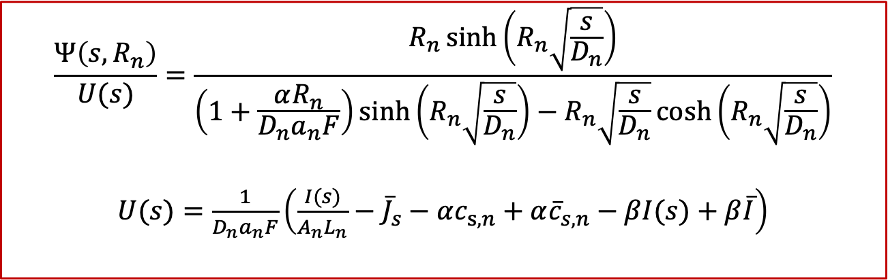
3. Model Reduction
Padé Approximation
Infinite-dimensional Transfer function of the battery model
$$\frac{Ψ\left(s,R_{n}\right)}{U(s)}=\frac{R_{n}\sinh\left(R_{n}\sqrt{\frac{s}{D_{n}}}\right)}{\left(1+\frac{αR_{n}}{D_{n}a_{n}F}\right)\sinh\left(R_{n}\sqrt{\frac{s}{D_{n}}}\right)−R_{n}\sqrt{\frac{s}{D_{n}}}\cosh\left(R_{n}\sqrt{\frac{s}{D_{n}}}\right)}$$
$U(s)=\frac{1}{D_{n}a_{n}F}\left(\frac{I(s)}{A_{n}L_{n}}−{\overline{J}}_{s}−αc_{s,n}+α{\overline{c}}_{s,n}−βI(s)+β\overline{I}\right)$
27
Notes:
To figure out the surface concentration we need to compute the transfer function between the input and output.
First, on the left side of the slides, we need to do a Laplace transform on spherical diffusion equation and apply the boundary conditions to get the transfer function.
After that, if you see the right side of the slides, I figured out the final solution of the transfer function of the real battery model on the single-particle model.
However, the transfer function is an infinite-dimensional transfer function that contains the exponential function.
So, we need to approximate this real model by doing the model reduction method.

Slide 29
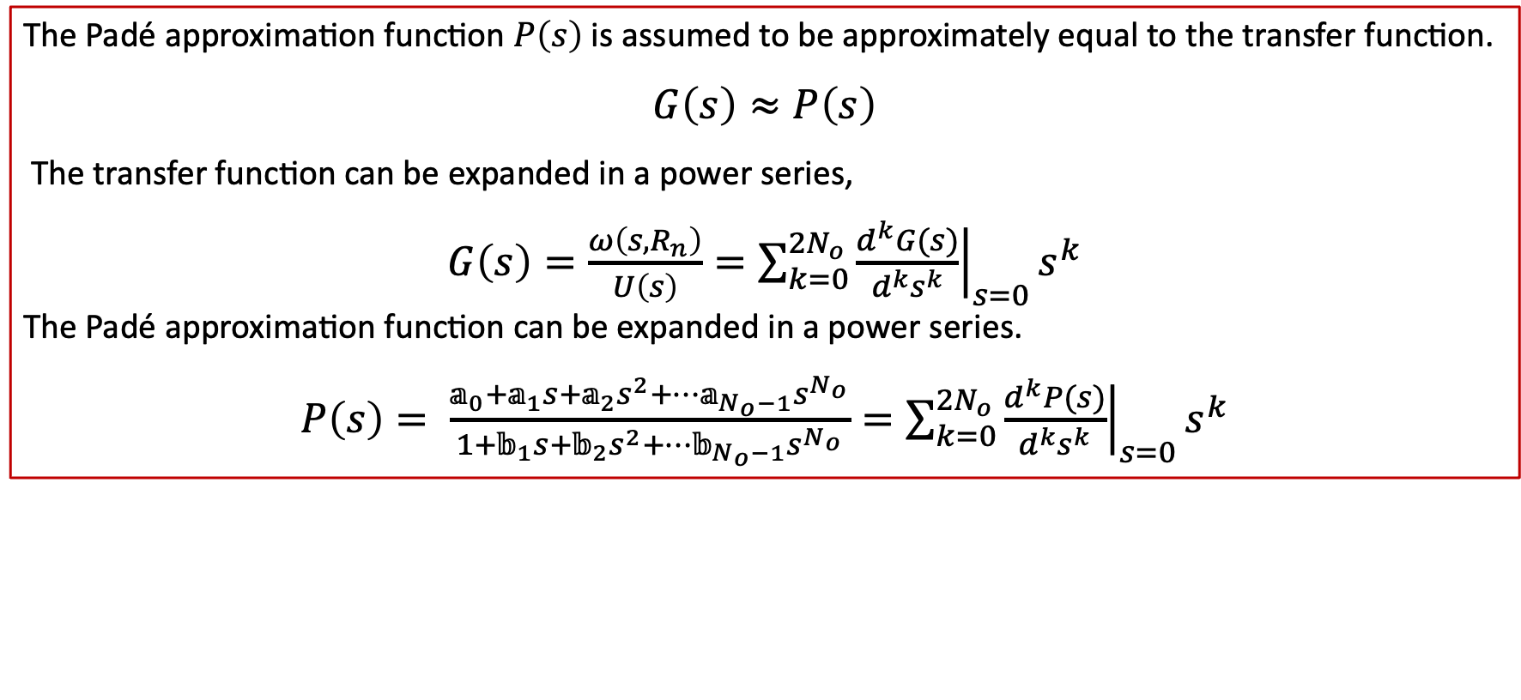
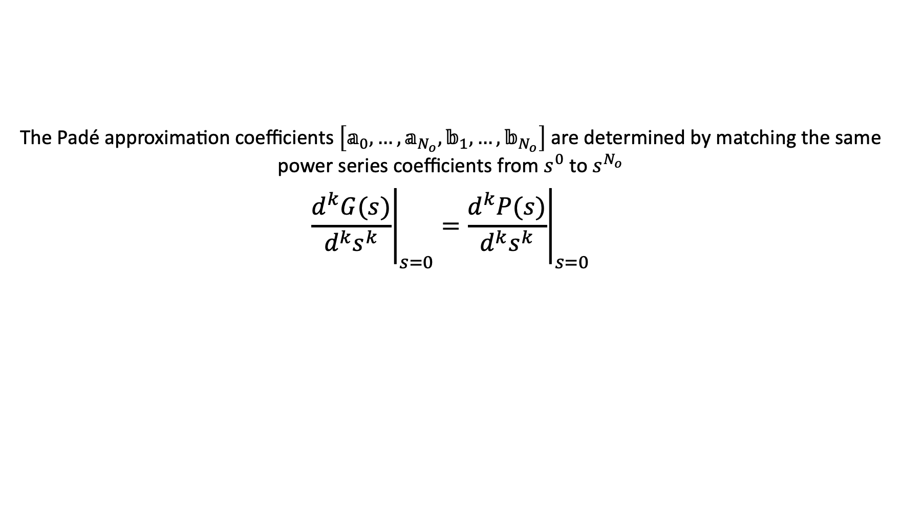
3. Model Reduction
Padé Approximation
The Padé approximation function $P\left(s\right)$ is assumed to be approximately equal to the transfer function.
$$G\left(s\right)≈P\left(s\right)$$
The transfer function can be expanded in a power series,
$G\left(s\right)=\frac{ω\left(s,R_{n}\right)}{U\left(s\right)}=\sum_{k=0}^{2N_{o}}{{\left.\frac{d^{k}G(s)}{d^{k}s^{k}}\right|}_{s=0}s^{k}}$
The Padé approximation function can be expanded in a power series.
$P\left(s\right)= \frac{𝕒_{0}+𝕒_{1}s+𝕒_{2}s^{2}+…𝕒_{N_{o}−1}s^{N_{o}}}{1+𝕓_{1}s+𝕓_{2}s^{2}+…𝕓_{N_{o}−1}s^{N_{o}}}=\sum_{k=0}^{2N_{o}}{{\left.\frac{d^{k}P(s)}{d^{k}s^{k}}\right|}_{s=0}s^{k}}$
The Padé approximation coefficients $\left[𝕒_{0},…,𝕒_{N_{o}},𝕓_{1},…,𝕓_{N_{o}}\right]$ are determined by matching the same power series coefficients from $s^{0}$ to $s^{N_{o}}$
$${\left.\frac{d^{k}G(s)}{d^{k}s^{k}}\right|}_{s=0}={\left.\frac{d^{k}P(s)}{d^{k}s^{k}}\right|}_{s=0}$$
28
Notes:
From this slide, I’ll explain briefly how to get the surface concentration using pade approximation in the transfer function.
First, we assume that the transfer function can be expanded in a power series.
Also, assume that the pade approximation form is nearly equal to transfer function of real model. Where the coefficients ck of the power series are calculated by repeated differentiation and evaluation of sG(s) at s=0.
I’ll explain with an example in the next slide.

Slide 30
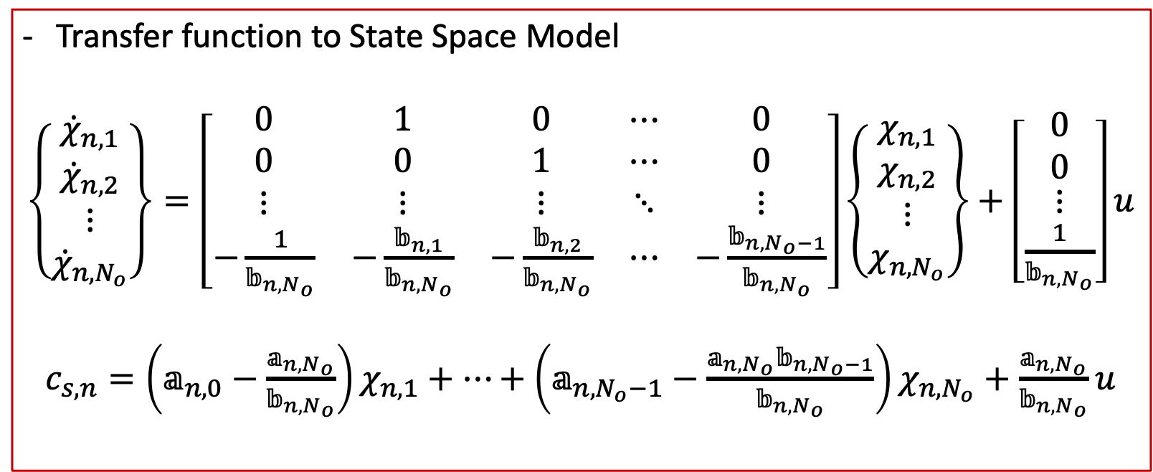
3. Model Reduction
Padé Approximation
Transfer function to State Space Model
$\left\{\begin{matrix}{\dot{χ}}_{n,1} \\ {\dot{χ}}_{n,2} \\ \begin{aligned}⋮ \\ {\dot{χ}}_{n,N_{o}}\end{aligned}\end{matrix}\right\}=\left[\begin{matrix}0 & 1 & 0 & ⋯ & 0 \\ 0 & 0 & 1 & ⋯ & 0 \\ ⋮ & ⋮ & ⋮ & ⋱ & ⋮ \\ −\frac{1}{𝕓_{n,N_{o}}} & −\frac{𝕓_{n,1}}{𝕓_{n,N_{o}}} & −\frac{𝕓_{n,2}}{𝕓_{n,N_{o}}} & ⋯ & −\frac{𝕓_{n,N_{o}−1}}{𝕓_{n,N_{o}}}\end{matrix}\right]\left\{\begin{matrix}χ_{n,1} \\ χ_{n,2} \\ \begin{aligned}⋮ \\ χ_{n,N_{o}}\end{aligned}\end{matrix}\right\}+\left[\begin{matrix}0 \\ 0 \\ \begin{aligned}⋮ \\ \frac{1}{𝕓_{n,N_{o}}}\end{aligned}\end{matrix}\right]u$
$c_{s,n}=\left(𝕒_{n,0}−\frac{𝕒_{n,N_{o}}}{𝕓_{n,N_{o}}}\right)χ_{n,1}+⋯+\left(𝕒_{n,N_{o}−1}−\frac{𝕒_{n,N_{o}}𝕓_{n,N_{o}−1}}{𝕓_{n,N_{o}}}\right)χ_{n,N_{o}}+\frac{𝕒_{n,N_{o}}}{𝕓_{n,N_{o}}}u$
→ Padé approximation function is converted to a state space model
29
Notes:
From the pade approximation of the transfer function which I got before; I changed this function to state space model which predict the output response of the battery systems to different inputs.
From the state space model X is the pade approximation states for each electrode. lambda is the eigenvalues of the diffusion model.
And beta is the coefficients which relate the pade approximate states to the surface concentration of lithium ions for each electrodes.

Slide 31


3. Model Reduction
Padé Approximation
2nd - Order
$$𝕒_{0}$$ | $\frac{D_{n}a_{n}F}{α}$ | $$𝕒_{1}$$ | $\frac{{R_{n}}^{2}a_{n}F}{9α}$ | $$𝕒_{2}$$ | $\frac{{R_{n}}^{4}a_{n}F}{945D_{n}α}$ | $𝕓_{2}$ | $−\frac{{R_{n}}^{3}\left(14D_{n}a_{n}F−R_{n}α\right)}{945{D_{n}}^{2}α}$ | $𝕓_{1}$ | $−\frac{R_{n}\left(3D_{n}a_{n}F−R_{n}α\right)}{9D_{n}α}$
3rd - Order
$$𝕒_{0}$$ | $\frac{D_{n}a_{n}F}{α}$ | $$𝕒_{1}$$ | $\frac{5{R_{n}}^{2}a_{n}F}{39α}$ | $$𝕒_{2}$$ | $\frac{2{R_{n}}^{4}a_{n}F}{715D_{n}α}$ | $$𝕒_{3}$$ | $\frac{{{a_{n}FR}_{p}}^{6}}{135135{{αD}_{p}}^{2}}$ | $$𝕓_{1}$$ | $−\frac{R_{n}\left(13D_{n}a_{n}F−5R_{n}α\right)}{39D_{n}α}$
 |  |  |  |  |  | $$𝕓_{2}$$ | $−\frac{2{R_{n}}^{3}\left(22D_{n}a_{n}F−3R_{n}α\right)}{2145{D_{n}}^{2}α}$ | $$𝕓_{3}$$ | $−\frac{{R_{n}}^{5}\left(27D_{n}a_{n}F−R_{n}α\right)}{135135{D_{n}}^{3}α}$
4th - Order
$$𝕒_{0}$$ | $\frac{D_{n}a_{n}F}{α}$ | $$𝕒_{1}$$ | $\frac{7{R_{n}}^{2}a_{n}F}{51α}$ | $$𝕒_{2}$$ | $\frac{{R_{n}}^{4}a_{n}F}{255D_{n}α}$ | $$𝕒_{3}$$ | $\frac{{{2a_{n}FR}_{p}}^{6}}{69615{{αD}_{p}}^{2}}$ | $$𝕒_{4}$$ | $\frac{{{a_{n}FR}_{p}}^{8}}{34459425{{αD}_{p}}^{3}}$
 |  | $$𝕓_{1}$$ | $−\frac{R_{n}\left(17D_{n}a_{n}F−7R_{n}α\right)}{51D_{n}α}$ | $$𝕓_{2}$$ | $−\frac{{R_{n}}^{3}\left(6D_{n}a_{n}F−R_{n}α\right)}{255{D_{n}}^{2}α}$ | $𝕓_{3}$ | $−\frac{2{R_{n}}^{5}\left(13D_{n}a_{n}F−R_{n}α\right)}{69615{D_{n}}^{3}α}$ | $𝕓_{4}$ | $−\frac{{R_{n}}^{7}\left(44D_{n}a_{n}F−R_{n}α\right)}{34459425{D_{n}}^{4}α}$
30
Notes:
By doing a calculation process which I explained before, I implemented on 2nd 3rd 4th order of pade approximation, and this table is the result of the calculation at each electrode and each orders.

Slide 32
Introduction
Lithium-Ion Battery Cell Model
Basics of Lithium-Ion Battery
The Single Particle Model
Model Reduction
Baseline Model Reduction Method
Optimization-based Model Reduction Method
Padé Approximation
Simulation and Optimization Setup
Results and Discussion
Conclusion
31

Slide 33


4. Simulation and Optimization Setup
Baseline Model Selection for FDM Battery Cell Model
Seven values of N are selected for simulation to determine the baseline value of N for the FDM with nonlinear degradation.
N=50 and N=100 are almost identical
→ N=50 FDM battery cell model is an appropriate selection when considering the tradeoff between the accuracy and the number of states for the FDM.
32
Notes:
From the pade approximation of the transfer function which I got before; I changed this function to state space model which predict the output response of the battery systems to different inputs.
From the state space model X is the pade approximation states for each electrode. lambda is the eigenvalues of the diffusion model.
And beta is the coefficients which relate the pade approximate states to the surface concentration of lithium ions for each electrodes.

Slide 34

4. Simulation and Optimization Setup
Optimization Setup
To determine the optimization-based reduced-order models, the MATLAB function ga is used from the MATLAB optimization toolbox
Computer cluster specification used to operate the GA code
GA options
Description | Optimization option value
Population size | No. of design variable $×$ 30
Crossover Fraction | 0.8
Mutation Fraction | Randomly generate directions
Max generation | 4000
Bounds | Lower bounds = -1 Upper bounds = 1
Description | Computer cluster specification
Type | CPU
Total nodes | 467
Cores/Processors | 18
Cores/Node | 36
Total cores in partition | 16,812
Memory/Node | 192 GB
Memory/Core | 5.33 GB
33
Notes:
From the pade approximation of the transfer function which I got before; I changed this function to state space model which predict the output response of the battery systems to different inputs.
From the state space model X is the pade approximation states for each electrode. lambda is the eigenvalues of the diffusion model.
And beta is the coefficients which relate the pade approximate states to the surface concentration of lithium ions for each electrodes.

Slide 35


4. Simulation and Optimization Setup
Optimization-based reduced-order model
${\dot{\vec{z}}}_{r}=A{\vec{z}}_{r}+BI$
$y_{r}=C{\vec{z}}_{r}+DI$
Objective function
$$𝒥=w_{1}\sqrt{\int_{0}^{t}{{\left(y_{true,1}−y_{r,1}\left(σ\right)\right)}^{2}dt}}+w_{2}\sqrt{\int_{0}^{t}{{\left(y_{true,2}−y_{r,2}\left(σ\right)\right)}^{2}dt}}$$
Optimization Setup
Two input current profiles are used to fit the design variable values
These are input to the N=50 FDM-based model to determine the true output trajectories for the
optimization-based reduced-order model to match
Pulse input
Sinusoidal wave input
34
Notes:
From the pade approximation of the transfer function which I got before; I changed this function to state space model which predict the output response of the battery systems to different inputs.
From the state space model X is the pade approximation states for each electrode. lambda is the eigenvalues of the diffusion model.
And beta is the coefficients which relate the pade approximate states to the surface concentration of lithium ions for each electrodes.

Slide 36

4. Simulation and Optimization Setup
Simulation Setup for validation
To validate the Padé-based and optimization based reduced-order models, two realistic input current profiles are used
Sinusoidal wave input for validation
UDDS current profile [39]
35
Notes:
The UDDS is an urban driving cycle with frequent braking and acceleration, with a 31.51 km/h average speed. The UDDS current profile was determined from a hybrid-electric vehicle (HEV) model simulated to match the UDDS driving cycle, with the necessary battery current to match the profile outputted

Slide 37
Introduction
Lithium-Ion Battery Cell Model
Basics of Lithium-Ion Battery
The Single Particle Model
Model Reduction
Baseline Model Reduction Method
Optimization-based Model Reduction Method
Padé Approximation
Simulation and Optimization Setup
Results and Discussion
Conclusion
36

Slide 38
5. Results and Discussion
Validation Results for General Degradation Reduced-Order Model
(1) The conventional Padé approximation model
(2) The proposed Padé approximation model
(3) The optimization-based model
VS
N=50 FDM battery cell model
37
Notes:
From the pade approximation of the transfer function which I got before; I changed this function to state space model which predict the output response of the battery systems to different inputs.
From the state space model X is the pade approximation states for each electrode. lambda is the eigenvalues of the diffusion model.
And beta is the coefficients which relate the pade approximate states to the surface concentration of lithium ions for each electrodes.

Slide 39


5. Results and Discussion
Validation Results for General Degradation Reduced-Order Model
Comparison of simulation results of 4th-order reduced-order models for the sinusoidal wave for validation profile
Negative surface concentration
Positive surface concentration
38
Notes:
From the pade approximation of the transfer function which I got before; I changed this function to state space model which predict the output response of the battery systems to different inputs.
From the state space model X is the pade approximation states for each electrode. lambda is the eigenvalues of the diffusion model.
And beta is the coefficients which relate the pade approximate states to the surface concentration of lithium ions for each electrodes.

Slide 40


5. Results and Discussion
Validation Results for General Degradation Reduced-Order Model
Comparison of simulation results of 4th-order reduced-order models for the sinusoidal wave for validation profile
Output Voltage
39
Notes:
From the pade approximation of the transfer function which I got before; I changed this function to state space model which predict the output response of the battery systems to different inputs.
From the state space model X is the pade approximation states for each electrode. lambda is the eigenvalues of the diffusion model.
And beta is the coefficients which relate the pade approximate states to the surface concentration of lithium ions for each electrodes.

Slide 41


5. Results and Discussion
Validation Results for General Degradation Reduced-Order Model
Comparison of simulation results of 4th-order reduced-order models for the UDDS current profile
Negative surface concentration
Positive surface concentration
40
Notes:
From the pade approximation of the transfer function which I got before; I changed this function to state space model which predict the output response of the battery systems to different inputs.
From the state space model X is the pade approximation states for each electrode. lambda is the eigenvalues of the diffusion model.
And beta is the coefficients which relate the pade approximate states to the surface concentration of lithium ions for each electrodes.

Slide 42


5. Results and Discussion
Validation Results for General Degradation Reduced-Order Model
Comparison of simulation results of 4th-order reduced-order models for the UDDS current profile
Output Voltage
41
Notes:
From the pade approximation of the transfer function which I got before; I changed this function to state space model which predict the output response of the battery systems to different inputs.
From the state space model X is the pade approximation states for each electrode. lambda is the eigenvalues of the diffusion model.
And beta is the coefficients which relate the pade approximate states to the surface concentration of lithium ions for each electrodes.

Slide 43


5. Results and Discussion
$𝒥_{m}=\sqrt{\int_{0}^{t}{{\left(y_{true,m}−y_{r,m}\left(σ\right)\right)}^{2}dt}}$
Validation Results for General Degradation Reduced-Order Model
Objective function values for the general degradation case study, with reduced-order models from 2nd- to 6th-order
61.7%
61%
51.8%
27%
2.98%
5%
Sinusoidal wave for validation
UDDS current profile
42
Notes:
O-B model has the lowest error per model order for the first three current profiles
Pade based model and O-B is of comparable accuracy in udds current profile
Similar error in higher order
Pade vs Pade-D
Lower order : error significant
Higher order: not too big

Slide 44

5. Results and Discussion
Validation Results for Increased Degradation Reduced-Order Model
To observe the battery degradation clearly in a short time span, the side reaction exchange current density $i_{o,s}$ is increased
$i_{o,s}=3.9∗{10}^{−12}\frac{A}{{cm}^{2}} → i_{o,s}=5.46∗{10}^{−8}\frac{A}{{cm}^{2}}$
Causes the battery to lose 10% of the total amount of lithium ions over the simulation time span
(1) The proposed Padé approximation model
(2) The optimization-based model
VS
N=50 FDM battery cell model
The conventional Padé approximation model is not evaluated in this section due to the increased rate of degradation
The positive surface concentration results are identical to the general degradation results
43
Notes:
From the pade approximation of the transfer function which I got before; I changed this function to state space model which predict the output response of the battery systems to different inputs.
From the state space model X is the pade approximation states for each electrode. lambda is the eigenvalues of the diffusion model.
And beta is the coefficients which relate the pade approximate states to the surface concentration of lithium ions for each electrodes.

Slide 45


5. Results and Discussion
Validation Results for Increased Degradation Reduced-Order Model
Comparison of simulation results of 4th-order reduced-order models for the sinusoidal wave for validation profile
Negative surface concentration
Output voltage
44
Notes:
From the pade approximation of the transfer function which I got before; I changed this function to state space model which predict the output response of the battery systems to different inputs.
From the state space model X is the pade approximation states for each electrode. lambda is the eigenvalues of the diffusion model.
And beta is the coefficients which relate the pade approximate states to the surface concentration of lithium ions for each electrodes.

Slide 46


5. Results and Discussion
Validation Results for Increased Degradation Reduced-Order Model
Comparison of simulation results of 4th-order reduced-order models for the UDDS current profile
Negative surface concentration
Output voltage
45
Notes:
From the pade approximation of the transfer function which I got before; I changed this function to state space model which predict the output response of the battery systems to different inputs.
From the state space model X is the pade approximation states for each electrode. lambda is the eigenvalues of the diffusion model.
And beta is the coefficients which relate the pade approximate states to the surface concentration of lithium ions for each electrodes.

Slide 47

5. Results and Discussion
Validation Results for Increased Degradation Reduced-Order Model
Objective function values for the increased degradation case study, with reduced-order models from 2nd- to 6th-order
56.8%
5%
Sinusoidal wave for validation
UDDS current profile
46
Notes:
56.8%
5%
Similar to the first case study
Pade-D error for the three input current profile show similar trends
Higher order Pade-D outperform the higher order O-B
O-B model show an increased trend in error in validation

Slide 48
Introduction
Lithium-Ion Battery Cell Model
Basics of Lithium-Ion Battery
The Single Particle Model
Model Reduction
Baseline Model Reduction Method
Optimization-based Model Reduction Method
Padé Approximation
Simulation and Optimization Setup
Results and Discussion
Conclusion
47

Slide 49



6. Conclusion
Basics of the Lithium-Ion Battery
Model Reduction
(1) Finite Difference Method
(2) optimization-based techniques
(3) Padé approximation
Simulation Results
Single Particle Model
48
Notes:
To analyze the accuracy

Slide 50
6. Conclusion
All reduced-order models can capture the output voltage as accurately as the
FDM battery cell model
Error value changes minimally after the 4th-order approximation
Padé VS Padé-D model
Accuracy: Padé < Padé-D at low model orders
Padé approximation with degradation method shows accurate performance at all cases
Optimization-Based model
Optimization-based methods can accurately capture the battery states for current profiles similar to the profiles used for optimization
Accuracy decreases for current profiles that differ greatly
Padé approximation requires calculation of the Padé approximation coefficients
O-B model requires high computational cost for the optimization process
49

Slide 51
Thank you

